Slide 1
Coding for New Physicians/ACPs
New Physician/ACP Orientation Team
Corporate Compliance
Revised October 2018

Slide 2
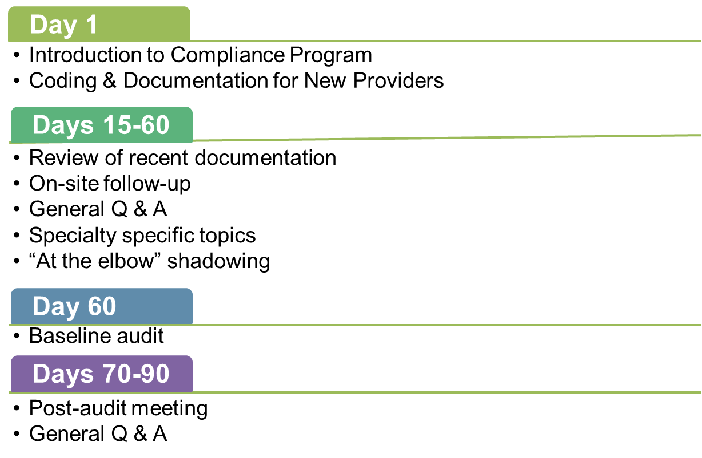
Timeline for New Physicians/ACPs

Slide 3
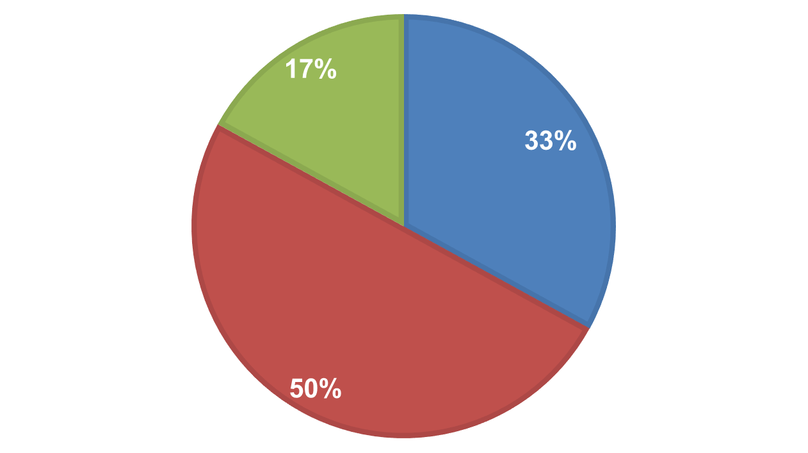
2016 Baseline* Audit Scores
Baseline score 100%
Baseline score 90 - 99%
Baseline score ≤89%
*The baseline audit is performed for all new Physicians/ACPs within 60 days of joining Atrium Health. It provides an opportunity to examine a Physician/ACP’s documentation, identify issues, make recommendations to improve documentation, address any questions the Physician/ACP may have, and tailor any additional education, beyond the basic Coding and Documentation program presented to new Physicians/ACPs during Orientation.

Slide 4
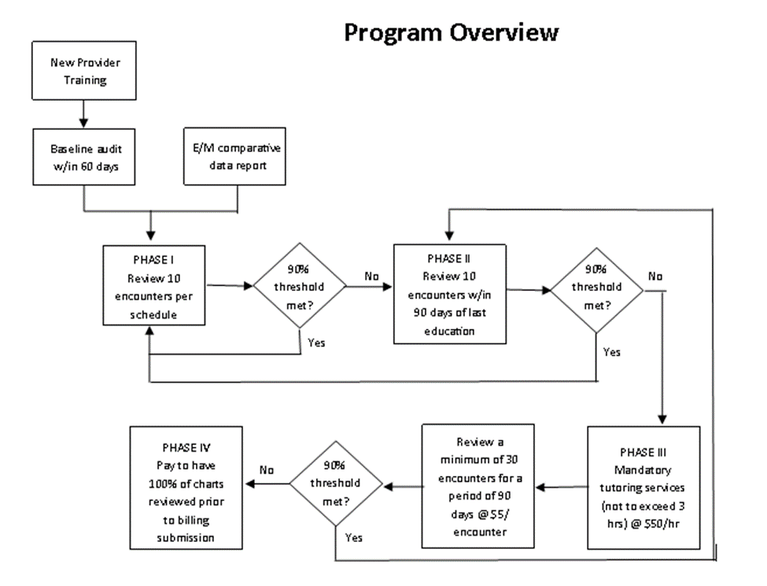
Compliance Program Overview

Slide 5
Compliance Program Overview
Phase Process
At the conclusion of each Physician/ACP review, the audit is scored and the compliance rate determines the “Phase” for the Physician/ACP. The phases are defined as:
Phase 1. Compliance threshold (90%) met or exceeded
Phase 2. Audit score falls below the 90% compliance threshold
Phase 3. Two (or more) consecutive audits fall below the 90% compliance threshold
Phase 4. Three (or more) consecutive audits fall below the 90% compliance threshold

Slide 6
Compliance Program Overview
Scoring
When scoring a Physician/ACP’s chart review findings, a “points” system is used. Points are weighted to reflect the risk that the error represents. Typically, ten (10) encounters are reviewed per Physician/ACP; each encounter is valued at 100 points, for a total of 1,000 possible points per audit.
The “points” scoring methodology allows Physician Compliance/Coding Support to prioritize education and follow up review based on identified risk(s).
Low risk error: 40 point deduction. Reviewer changed the E/M code by one level
Moderate risk error: 80 point deduction. E/M code change > one level, E/M code category changed
High risk error: 100 point deduction. Missing or insufficient documentation to support any E/M service or procedure

Slide 7
Compliance Program Overview
Audit Finding | Points | Description
Delete CPT | -100 | No medical record documentation to support CPT code
E/M No Code | -100 | No medical record documentation to support an E/M service
CPT Change – Overcode | -80 | Medical record documentation supports a different CPT code than selected, resulting in an overcode
E/M Category Change – Overcode | -80 | Medical record documentation supports an E/M code from a different E/M category, resulting in an overcode
E/M Undercoded by 2-4 levels | -80 | Medical record documentation supports a higher level E/M code than selected
E/M Overcoded by 2-4 levels | -80 | Medical record documentation supports a lower level E/M code than selected
E/M Undercoded by 1 level | -40 | Medical record documentation supports a higher level E/M code than selected
E/M Overcoded by 1 level | -40 | Medical record documentation supports a lower level E/M code than selected

Slide 8
Compliance Program Overview
Physician Compliance/Coding Support use Evaluation and Management (E/M) comparative data to evaluate Physicians/ACPs’ coding patterns and identify trends where additional analysis may be needed. These dashboard reports include all payers and are updated monthly for the following E/M code categories:
  New and established patients
  Inpatient and outpatient consults
  Hospital admissions and subsequent visits
The Code Distribution Index (CDI) and Physician E/M Profile dashboard reports are available on eLink. Although the dashboard reports have proven valuable in assessing Physicians/ACPs’ code selection tendencies in order to appropriately schedule audits, shadowing and education, the appropriateness of a Physician/ACP’s code selection can only be determined through chart review

Slide 9
Urgent Alert – New Law Impacts South Carolina Physicians/ACPs
South Carolina’s state legislators have been working to help control an opioid epidemic that is impacting communities across the United States. Effective May 19, 2017, prescribers who practice in South Carolina:
Must now review a patient’s controlled substance prescription history, as maintained in the prescription monitoring program, BEFORE the practitioner issues a prescription for a Schedule II controlled substance
The new law only applies to a patient who is seen in South Carolina, and does not apply when a South Carolina patient is seen by a North Carolina Physician/ACP
Notes:
Additional information on this law, including hyperlinks to the South Carolina Dept. of Health and Human Services, will be included in your introductory email.

Slide 10
Urgent Alert – New Law Impacts South Carolina Physicians/ACPs
North Carolina Prescribers:
Under a separate South Carolina Medicaid regulation issued April 1, 2016, North Carolina Physicians/ACPs issuing any controlled substance (DEA Schedules II through IV) for a South Carolina Medicaid patient must “first evaluate the beneficiary’s controlled substance history through SCRIPTS.” Of note, South Carolina Medicaid defines their service area as “within 25 miles of the state line.”
Notes:
Additional information on this law, including hyperlinks to the South Carolina Dept. of Health and Human Services, will be included in your introductory email.

Slide 11
Additional Information About Today’s Topics
Streaming videos are available that cover most of the topics addressed today. You may access them on the Atrium Health intranet:
  PhysicianConnect > Education > Coding & Documentation
  Most are approximately 10 minutes in duration
  These are updated as needed to reflect changes in regulations, so please review them periodically
Additional educational material can also be viewed by accessing this link, including:
  The current edition and archives of The Link newsletter
  Job aids
  Code Distribution Index (CDI)
  Physician E/M Profiles

Slide 12
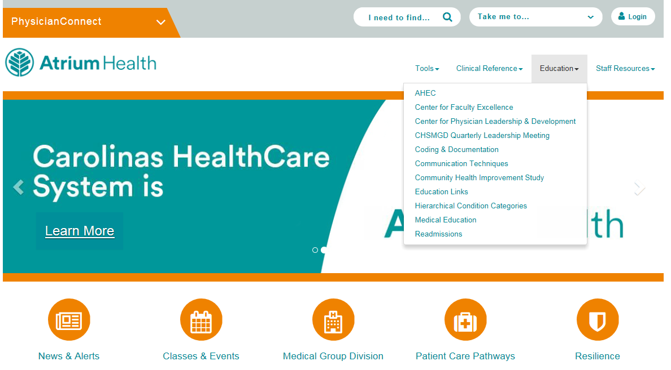
Accessing Coding & Documentation Resources via Physician Connect

Slide 13
Today’s Agenda
Medical necessity
E/M Coding Key Elements:
  Complexity of Medical Decision Making (MDM)
  History
  Examination
Time-based billing
Putting it all together: Selecting your code
Reporting Advance Clinical Practitioner services
Additional coding and documentation topics:
Critical care services
Consultations
EMR cautions
Signature requirements
Timeliness of documentation
Scribes
Diagnosis Coding
Related claims
Research

Slide 14
Today’s Agenda
Appendices
Teaching Physicians, Residents, & Medical Students
B. Primary Care Exception
C. Preventive Medicine Visits
D. Preventive/Split Services
E. Smoking Cessation Counseling
F. Commonly Performed Office Procedures
G. Advance Care Planning
Telehealth Services
I. Alcohol/Substance Abuse, Brief Intervention, & Referral to Treatment Services (SBIRT)
J. Transitional Care Management (TCM)
K. Home Health Face-to-Face Requirements (Medicare)
L. Advanced Beneficiary Notice of Non-Coverage (ABN)

Slide 15
Evaluation and Management (E/M) Services
Includes services such as office visits, hospital visits, and consultations
Documentation requirements developed jointly by the American Medical Association (AMA) and the Centers for Medicare and Medicaid Services (CMS):
      1995 Evaluation and Management Documentation Guidelines
      1997 Evaluation and Management Documentation Guidelines

Slide 16
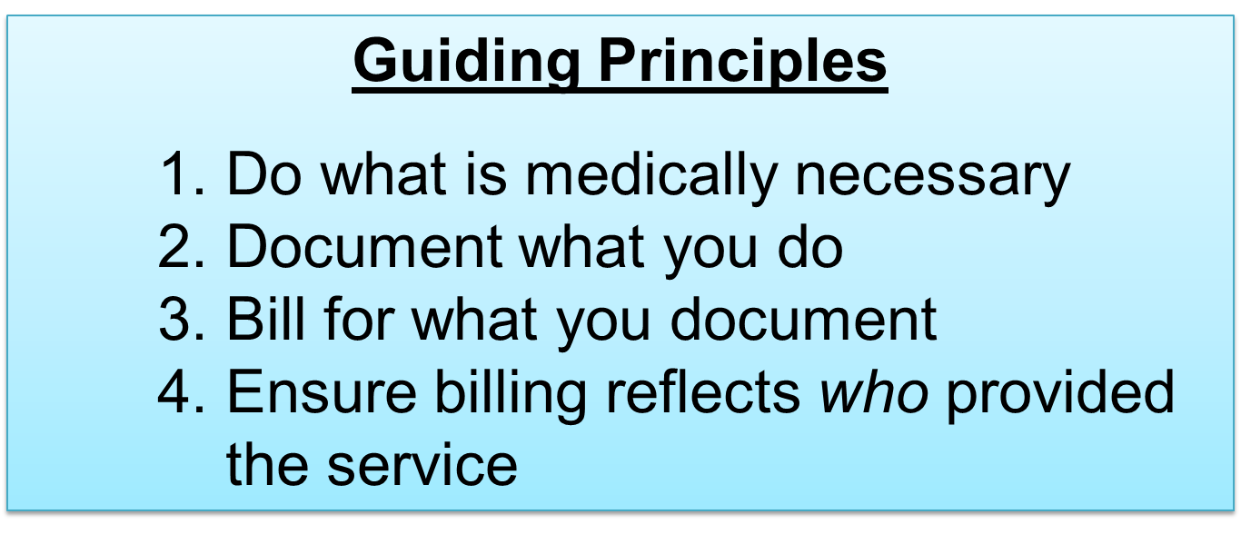
Evaluation and Management (E/M) Services

Slide 17
Medical Necessity

Slide 18
Medical Necessity - The Why
“Medical necessity of a service is the overarching criterion for payment in addition to the individual requirements of a CPT code. It would not be medically necessary or appropriate to bill a higher level of E/M service when a lower level of service is warranted. The volume of documentation entered in the medical record should not be the primary influence upon which a specific level of service is billed. Documentation should support the level of service reported. The service should be documented during, or as soon as practicable after it is provided in order to maintain an accurate medical record.”¹
¹ Medicare Carriers Manual, IOM 100-4, Chapter 12, Section 30.6.1.A http://www.cms.hhs.gov/transmittals/downloads/R178CP.pdf

Slide 19
What is Medical Necessity?
Medicare defines medically necessary services as “healthcare services or supplies needed to prevent, diagnose, or treat an illness, injury, condition, disease, or its symptoms and that meet accepted standards of medicine”
An important requirement to receive payment for services is to establish medical necessity by documenting the following facts and findings:
  Severity of the signs/symptoms or diagnosis exhibited by the patient
  Probable outcome for the patient, and how that risk equates to the diagnosis being evaluated
  Need for diagnostic studies and/or therapeutic interventions to evaluate the patient’s presenting problem or current medical condition
Documentation of all medical care should accurately reflect the need for and outcome of treatment

Slide 20
Medical Necessity
Medical necessity relates to whether a service is considered appropriate in a given circumstance
Services provided to a patient must be reasonable, necessary, and appropriate based on clinical standards of care
It is the necessity of the service versus the volume of the documentation that determines the level of service which should be reported
  Although performing a comprehensive history and exam may be a Physician/ACP’s style of practice it may not be considered medically necessary and, therefore, not billable

Slide 21
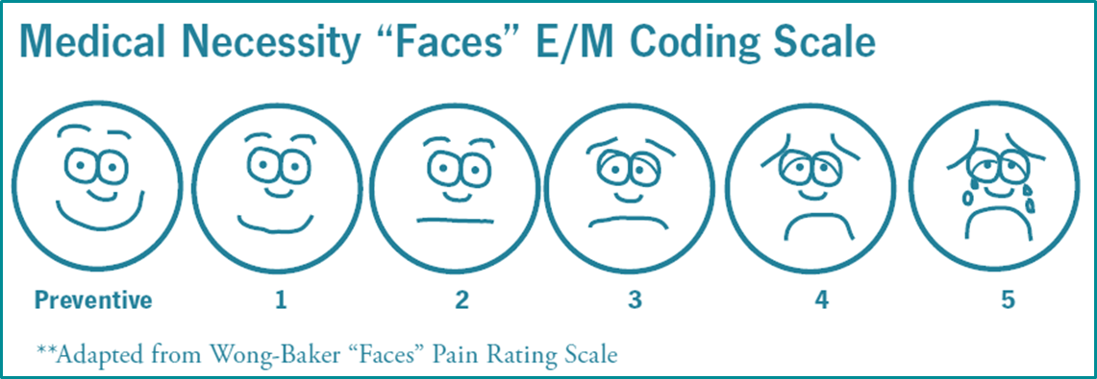
Medical Necessity
The five levels of service in office visits can be visualized using the same logic as a pain chart
Levels 3 – 5 are usually reported for sick patients and lower levels of service are reported for patients with minor or controlled conditions

Slide 22
Complexity of Medical Decision Making (MDM)

Slide 23
Medical Decision Making (MDM)
Refers to the complexity of establishing a diagnosis and/or selecting a management option based on:
Number of possible diagnoses and/or treatment options
Amount and/or complexity of data obtained, reviewed, or analyzed
Risk of significant complication, morbidity and/or mortality; including comorbidities associated with the presenting problems(s), diagnostic procedures(s), and/or possible management options

Slide 24
MDM formula
2 out of 3 of ABC = MDM
Two out of three of the components must meet or exceed the requirements to reach a given level of decision-making
A | Number of Diagnoses or Treatment Options
B | Amount and/or Complexity of Data
C | Risk associated with patient’s condition

Slide 25
A = Number of Diagnoses or Treatment
Options
Consider the problems addressed during the encounter
Decision making may be easier for an established problem that was previously evaluated and treated by the Physician/ACP than for a new problem
Established problems that are improving are less complex than worsening problems or problems that are not improving as expected

Slide 26
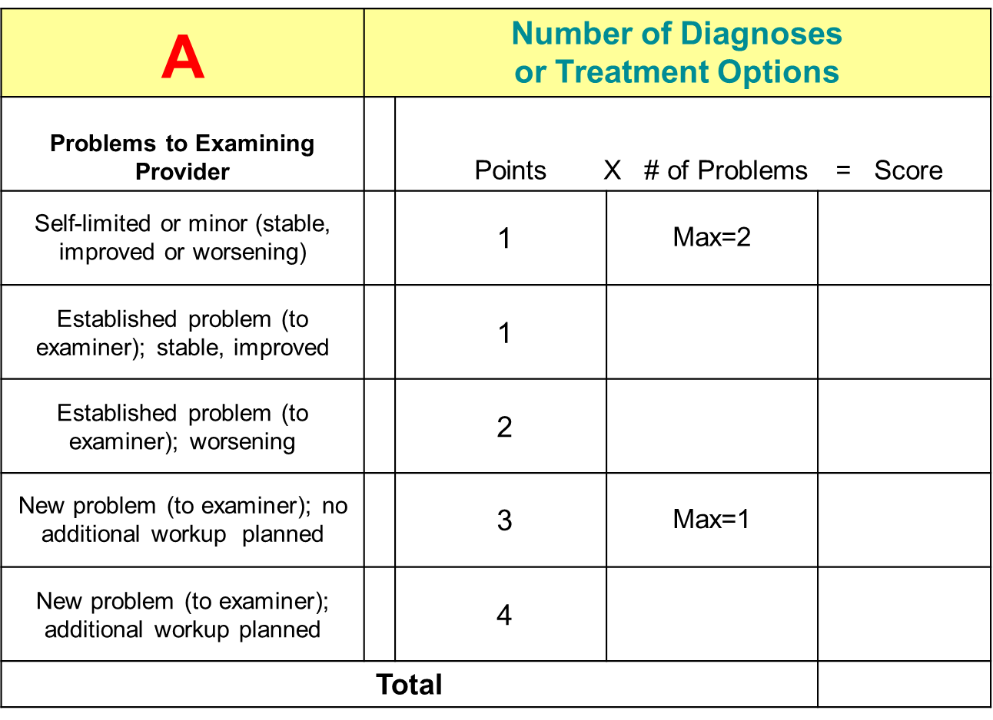
A = Number of Diagnoses or Treatment
Options

Slide 27
Additional Info About How Diagnoses are Counted
New problem “to examiner”
  Physicians/ACPs will receive 3 or 4 point credit when evaluating a problem for the first time, even if that problem was previously treated by another Physician/ACP within the same group practice

Slide 28
B = Amount and/or Complexity of Data
Consider the data reviewed, discussions held about the patient, and tests ordered during the encounter
The more data addressed during the encounter, the more complex the decision-making

Slide 29
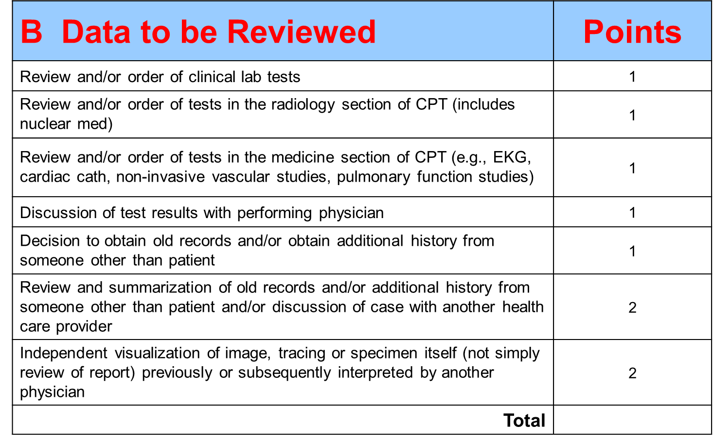
B = Amount and/or Complexity of Data

Slide 30
Additional Info About How Data is Counted
Review and summarization of old records:
  Must include brief summary of relevant information from old records
  Credit is given for review and summary of another Physician/ACP’s medical records (different practice/group/specialty) but not review and summary of a Physician/ACP’s own previous records

Slide 31
Additional Info About How Data is Counted
Discussion of case with another health care Physician/ACP:
  Must document what was discussed
  Does not include discussion with nursing staff or supervising physician by an Advanced Clinical Practitioner or Resident
  Does not include discussion with other Physicians/ACPs in same practice when “handing off” care of patient at end of shift

Slide 32
Additional Info About How Data is Counted
Independent visualization of image, tracing or specimen
  Notice the word “independent”
  Includes tests conducted and billed for by another physician
  Credit is not given for visualization of results of tests conducted and billed for by the Physician/ACP documenting the E/M service or otherwise billing for professional interpretation (e.g., x-ray)
“Personal review of image shows …”

Slide 33

C = Risk Associated with Patient’s
Condition
See Table of Risk on the audit tool handout
Based on three components:
  Presenting problem(s)
  Diagnostic procedure(s) ordered
  Management option(s) selected

Slide 34
C = Risk Associated with Patient’s
Condition
Highest of 3 components determines level of risk
Consider the risk related to the disease process anticipated between the present encounter and the next one
The assessment of risk related to diagnostic procedures and management options is based on the risk during and immediately following any procedures or treatment
If evaluating and treating an ongoing problem, clearly document the severity of the problem during that encounter

Slide 35
C = Risk Associated with Patient’s
Condition
All surgical procedures have inherent risk. Consider the risk factors that exceed those usually associated with the procedure
Identified factors associated with surgical procedures that indicate high risk include:
  Advanced age or debility
  Extremely young age (under the age of one)
  Prior surgical difficulties
  Underlying cardiac or pulmonary disease

Slide 36
C = Risk Associated with Patient’s
Condition
Management Options: Drug Therapy Requiring Intensive Monitoring for Toxicity
Drugs that have a narrow therapeutic window and a low therapeutic index may exhibit toxicity at concentrations close to the upper limit of the therapeutic range and may require intensive clinical monitoring
On medical review, to consider therapy with one of these drugs as a high risk management option, we would expect to see documentation in the medical record of drug levels obtained at appropriate intervals
Administration of cytotoxic chemotherapy is always considered high risk under management options when monitoring of blood cell counts is used as a surrogate for toxicity

Slide 37
C = Risk Associated with Patient’s
Condition
Examples of drugs that may need to have drug levels monitored for toxicity (this is not an all-inclusive list)
Drug Category | Drugs in that Category | Treatment Use
Cardiac | Digoxin, Amiodarone | Arrhythmias, CHF
Anticoagulants | Coumadin, IV Heparin | Prevention of thrombosis
Antiepileptic | Phenobarbital, Valproic Acid | Prevention of seizures
Bronchodilators | Theophylline, Caffeine | Asthma, COPD
Anti-Cancer | All cytotoxic agents | Rejection prevention, autoimmune disorders
Immunosuppressant | Tacrolimus, Cyclosporine | Malignancies
Antibiotics | Vancomycin, Gentamycin | Bacterial infections that are resistant to less toxic antibiotics
Insulin/Anti-Diabetic | IV Insulin drip | Hyperglycemia

Slide 38
Calculate the MDM
Patient seen today for follow up of well controlled hypertension and diabetes. Prescriptions written for refills.
A
Number of Diagnoses
(2 established, stable) 2 points
B
Data NONE
C
Risk Table
(Rx drug management and MODERATE
2 stable chronics)

Slide 39
Calculate the MDM
 | Final Result of Complexity
Draw a line down the column with 2 or 3 circles and circle decision making level OR draw a line down the column with the middle circle and circle the decision making level.
A | Number diagnoses or treatment options | < 1 Minimal | 2 Limited | 3 Multiple | > 4 Extensive
B | Amount and complexity of data | < 1 Minimal or low | 2 Limited | 3 Moderate | > 4 Extensive
C | Highest risk | Minimal | Low | Moderate | High
Type of decision making |  | Straight- Forward | Low Complexity | Moderate Complexity | High Complexity

Slide 40
Calculate the MDM
Patient returns to the office with well-controlled diabetes and reports lingering cough. A chest x-ray is taken in the office and the Physician/ACP reviews and finds left lower lobe pneumonia. Prescriptions are given for an antibiotic and corticosteroid. Physician/ACP also asked patient to monitor and log blood sugars while on the Prednisone.
A
Number of Diagnoses
(1 established, stable) 1 point
(1 new with work-up) 4 points
B
Data
(chest x-ray) 1 point
C
Risk Table
(Acute illness w/systemic symptoms) MODERATE
(1 stable chronic)
(Rx drug management)

Slide 41
Calculate the MDM
 | Final Result of Complexity
Draw a line down the column with 2 or 3 circles and circle decision making level OR draw a line down the column with the middle circle and circle the decision making level.
A | Number diagnoses or treatment options | < 1 Minimal | 2 Limited | 3 Multiple | > 4 Extensive
B | Amount and complexity of data | < 1 Minimal or low | 2 Limited | 3 Moderate | > 4 Extensive
C | Highest risk | Minimal | Low | Moderate | High
Type of decision making |  | Straight- Forward | Low Complexity | Moderate Complexity | High Complexity

Slide 42
Calculate the MDM
Patient presents to PCP complaining of severe shortness of breath. Patient’s pulse ox is 86%. PCP does chest x-ray and compares it to last chest x-ray performed by patient’s pulmonologist, also documenting personal review of the image.
A
Number of Diagnoses
(1 new with work-up) 4 points
B
Data
(chest x-ray) 1 point
(pulse ox – medicine section) 1 point
(Independent visualization) 2 points
C
Risk Table
(Acute illness that may pose threat HIGH
to life)

Slide 43
Calculate the MDM
 | Final Result of Complexity
Draw a line down the column with 2 or 3 circles and circle decision making level OR draw a line down the column with the middle circle and circle the decision making level.
A | Number diagnoses or treatment options | < 1 Minimal | 2 Limited | 3 Multiple | > 4 Extensive
B | Amount and complexity of data | < 1 Minimal or low | 2 Limited | 3 Moderate | > 4 Extensive
C | Highest risk | Minimal | Low | Moderate | High
Type of decision making |  | Straight- Forward | Low Complexity | Moderate Complexity | High Complexity

Slide 44
Calculate the MDM
Physician/ACP is making daily rounds and finds patient’s infected decubitus ulcer is worse. She orders CBC with diff and glucose level. She reviews blood cultures showing infection. IV Vancomycin is ordered.
A
Number of Diagnoses
(1 established, worsening) 2 points
B
Data
(glucose, CBC/diff, blood cultures) 1 point
C
Risk Table
(Chronic w/mild exacerbation) HIGH
(Toxic drug requiring monitoring)

Slide 45
Calculate the MDM
 | Final Result of Complexity
Draw a line down the column with 2 or 3 circles and circle decision making level OR draw a line down the column with the middle circle and circle the decision making level.
A | Number diagnoses or treatment options | < 1 Minimal | 2 Limited | 3 Multiple | > 4 Extensive
B | Amount and complexity of data | < 1 Minimal or low | 2 Limited | 3 Moderate | > 4 Extensive
C | Highest risk | Minimal | Low | Moderate | High
Type of decision making |  | Straight- Forward | Low Complexity | Moderate Complexity | High Complexity

Slide 46
Calculate the MDM
Hospitalist is called to see patient who remains unconscious after a fall that occurred 1 hour ago. Physician/ACP orders Head CT scan, CMP, CBC with Diff, Ammonia Level, and EKG and intravenous fluids for hydration.
A
Number of Diagnoses
(1 new with work-up) 4 points
B
Data
(CMP, CBC/diff, ammonia) 1 point
(Head CT) 1 point
(EKG) 1 point
C
Risk Table
(Acute injury that may pose threat to life) HIGH
(IV fluids w/o additives)

Slide 47
Calculate the MDM
 | Final Result of Complexity
Draw a line down the column with 2 or 3 circles and circle decision making level OR draw a line down the column with the middle circle and circle the decision making level.
A | Number diagnoses or treatment options | < 1 Minimal | 2 Limited | 3 Multiple | > 4 Extensive
B | Amount and complexity of data | < 1 Minimal or low | 2 Limited | 3 Moderate | > 4 Extensive
C | Highest risk | Minimal | Low | Moderate | High
Type of decision making |  | Straight- Forward | Low Complexity | Moderate Complexity | High Complexity

Slide 48
Medical Decision Making:
Coding and Documentation Risk Areas
The most common risk areas of the MDM portion of Physicians/ACPs’ documentation includes:
  Not listing all problems addressed during the encounter
  Not clearly describing the severity of the problems addressed during the encounter including whether they are worsening or not improving as expected
  Incomplete documentation of the data reviewed especially discussions with other healthcare Physicians/ACPs and personal review of images, tracings and specimens

Slide 49
History

Slide 50
History
Consists of four subcomponents:
  Chief Complaint (CC)
  History of Present Illness (HPI)
  Review of Systems (ROS)
  Past, Family, and Social History (PFSH)

Slide 51
Chief Complaint
A concise statement describing the symptom, problem, condition, diagnosis, physician recommended return, or other factor that is the reason for the encounter
  Establishes the medical necessity for the visit
    Not necessarily an acute condition; follow up of chronic conditions is permitted
    Be sure to state what is being followed, e.g., “Patient is here for follow up of hypertension”

Slide 52
History of Present Illness (HPI)
HPI is a chronological description of the development of the patient’s present illness from the first sign and/or symptom or from the previous encounter to the present
Documentation guidelines use eight indicators to describe the HPI

Slide 53
History of Present Illness (HPI)
Location – where is the problem?
Duration – how long has the problem existed?
Quality – what descriptive terms or characteristics describe the problem (e.g., “sharp” pain, “productive” cough)?
Severity – how bad is the problem?
Timing – when does the problem occur?
Context – what was happening when the patient was injured or became ill?
Modifying factors – what treatments has the patient tried?
Associated signs and symptoms – what other symptoms does the patient describe?

Slide 54
Patient presents with severe, stabbing back pain he has experienced intermittently for one month. The pain began after a fall while playing soccer. Patient has taken Motrin with minimal relief. He also complains of right leg tingling.
Example - History of Present Illness (HPI)
Indicator | From Example
Location
Quality
Severity
Duration
Timing
Context
Modifying Factors
Associated Signs and Symptoms
Back
Stabbing
Severe
One month
Intermittently
Fall while playing soccer
Minimal relief with Motrin
Right leg tingling

Slide 55
The patient presents for follow-up. The patient is completely asymptomatic from a cardiovascular standpoint. Denies chest pain, shortness of breath, syncope or near syncope.
Example - History of Present Illness (HPI)
Indicator | From Example
Location
Quality
Severity
Duration
Timing
Context
Modifying Factors
Associated Signs and Symptoms
No chest pain, shortness of breath, syncope, or near syncope

Slide 56
History of Present Illness (HPI)
Only portion of the history that must be recorded by the Physician/ACP
Unacceptable comments include:
  “See nurse’s notes”
  “Agree with above”
If a nurse (or other ancillary staff) records the information, the Physician/ACP must re-state it, adding or amending as appropriate
High level codes in most categories require documentation of a minimum of four indicators (i.e., extended HPI)

Slide 57
Alternative HPI: Chronic Conditions
Documentation of the status of three chronic conditions is considered equivalent to documenting four or more HPI indicators
The status of the conditions must be documented
    e.g., well-controlled hypertension, DM with increasing a.m. blood sugars, worsening osteoarthritis pain

Slide 58
Review of Systems (ROS)
The ROS is an inventory of body systems obtained through a series of questions seeking to identify signs and/or symptoms which the patient may be experiencing or has experienced
Think “review of symptoms”

Slide 59
Review of Systems (ROS)
Fourteen systems are available for review:
Constitutional
Eyes
ENT
Cardiovascular
Respiratory
Gastrointestinal
Genitourinary
Musculoskeletal
Integumentary-Skin/Breast
Neurological
Psychiatric
Endocrine
Hematologic/Lymphatic
Allergic/Immunologic

Slide 60
Example – Review of Systems (ROS)
Eyes
Constitutional
Cardio
Patient describes weight loss of 10 lbs in past month. No visual disturbances. Occasional palpitations. Pneumonia six months ago. No GI symptoms. Fractured femur in MVA in 2006. No problems with depression or anxiety.
Gastro
Past
Medical
History
Psych

Slide 61

Example – Review of Systems (ROS)
Constitutional: Denies fever, no chills. Weight loss of 5lbs
Respiratory: Mild shortness of breath
Cardiovascular: Negative
Gastrointestinal: Denies diarrhea, constipation
Genitourinary: Frequent urination at night
All other systems reviewed and negative at this time
This is appropriate documentation of a Complete Review of Systems
  Positives, pertinent negatives, and a summary statement have been documented

Slide 62

Example - Review of Systems (ROS)
ROS: Other than what is stated in the HPI, all others are negative
This statement may be counted as a complete ROS only if there is at least one comment in the HPI that can be counted as ROS
Notes:
For example, the Physician/ACP documents positive associated signs/symptoms. He/she also documents multiple negative associated signs/symptoms. The negative responses can be used as ROS.

Slide 63
Review of Systems (ROS)
Who can record the Review of Systems?
  ROS can be recorded by ancillary staff in the EMR
  ROS can be obtained from the information completed by the patient on the patient history form
    The patient history form should be reviewed and modified as needed, signed or initialed, and dated by the Physician/ACP.
    It should also be referenced in the Physician/ACP’s note. (e.g., “Please refer to scanned patient history form, dated and reviewed by me today”)

Slide 64
Review of Systems (ROS)
When you do a medically necessary full review of systems, you may document your positive and pertinent negative findings and then state “All others negative” and receive credit for all 14 systems
  Do not state “All others noncontributory”
It is not expected that a Physician/ACP would always document “all others negative” since that level of detail is not always medically necessary

Slide 65
Review of Systems (ROS)
If you are using a handwritten template and the “all others negative” box is checked without positives or pertinent negatives noted, it is not considered a complete ROS
  Must document at least one system
A straight line through check boxes does not count on a handwritten form or template
High level codes in most categories require documentation of 10 or more systems for ROS

Slide 66
Past, Family, Social History (PFSH)
Past Medical History:
  Current medications, past surgeries, past illnesses
Family History:
  Family medical history relating to patient’s current illness; high risk or hereditary diseases that may place the patient at risk
Social History:
  Use of tobacco or alcohol, living arrangements, occupation, marital status

Slide 67
Past, Family, Social History (PFSH)
Who can record the PFSH?
  PFSH can be recorded by ancillary staff in the EMR
  PFSH can be recorded from the information on the patient history form
    The patient history form should be reviewed and modified as needed, signed or initialed, and dated by the Physician/ACP. It should also be referenced in the Physician/ACP’s note. (e.g., “Please refer to scanned patient history form, dated and reviewed by me today”)

Slide 68
Past, Family, Social History (PFSH)
Stating “negative,” “noncontributory,” “unremarkable,” or “unknown” is not considered sufficient documentation
    Specific information must be described
    Although Canopy options currently include: noncontributory, negative, not significant, etc., you will need to identify specific aspects of PFSH
    Example: family history negative for lung cancer
If the family history is unknown (e.g., adoption), document the reason and credit will be given
    Example: Family history unknown due to adoption.
Most high level codes require documentation of all three components

Slide 69
Example - Past, Family, Social History
New patient presents for evaluation of chest pain.
Past medical history: MI in 2012, and CVA in 2014
Family history: Father deceased from MI at age 53, mother still living but in poor health (lung cancer)
Social history: Patient smokes two packs of cigarettes per day, drinks socially on occasion
This is appropriate documentation of a Complete PFSH
  All three areas of history are addressed

Slide 70
Example - Past, Family, Social History
Patient presents for evaluation of headaches
Past medical history: Hypertension and gastroesophageal reflux
Family history: Non-contributory
Social History: Patient smokes a half pack of cigarettes per day, denies alcohol use or drug abuse
Only Past Medical history and Social history are documented properly
  “negative,” “noncontributory,” “unremarkable,” or “unknown” are not considered sufficient

Slide 71
Four History Levels
Problem Focused: 1 HPI
Expanded Problem Focused: 1 HPI and 1 ROS
Detailed: 4 HPI, 2 – 9 ROS, 1 PFSH*
Comprehensive: 4 HPI, 10 ROS, all 3 PFSH**
* For subsequent inpatient care, the PFSH is not necessary for a Detailed History
** For Emergency Room visits, 2 of 3 of the PFSH is required for a Comprehensive History

Slide 72
History Levels
Detailed vs. Comprehensive
Detailed History
Chief Complaint
4+ HPI indicators
2 - 9 ROS
1 of PFSH
Comprehensive History
Chief Complaint
4+ HPI indicators
10 or more ROS
All 3 of PFSH
If the documentation supports a detailed history instead of a comprehensive history, the code supported may be as much as two levels lower. Compare various code levels on your laminated card, for example 99221 – 99223
Notes:
The lowest initial hospital visit requires DETAILED Hx.

Slide 73
Key Points to Remember
A chief complaint must be documented for every encounter
HPI must be documented by the Physician/ACP, not ancillary staff
The patient or office staff may record the ROS and PFSH on a patient history form. The Physician/ACP must review, sign or initial, and date the form and refer to it in his/her documentation
Past, family and social history may not be described as “noncontributory”, “negative” or “unknown”
If family history is unknown, documentation of the reason will support the family history and credit will be given for that component

Slide 74
Key Points to Remember
If the history is unobtainable from the patient or other source, the record should state so and describe the patient’s condition or other circumstance which precludes obtaining the history. Credit will then be given for a comprehensive history
    “Patient is a poor historian” is not considered adequate support for a comprehensive history
Coding and documentation risk areas include:
    Not documenting four HPI indicators for higher level codes
    Missing family history
    Incomplete review of systems, i.e., fewer than 10 organ systems addressed for higher level codes

Slide 75
History – Let’s Practice
Patient presents for evaluation of back and neck pain. Involved in a MVA last night where he was t-boned by another car who ran a red light. Was hit on driver’s side door and airbags deployed. Considerable pain from left neck, left shoulder and left rib cage. Also experiencing on and off dizziness and blurry vision. Has been taking 800mg of ibuprofen with limited relief. No numbness, tingling, sob, or nausea. Non-smoker.
Review of Systems
Constitutional: Negative
Eyes: Negative except as indicated in HPI
Hematologic/Lymphatic: Bruising left shoulder
Cardiovascular: No chest pain
Allergies: NKA
Medications: lisinopril 10 mg oral tablet: 10mg, 1 tablet daily.
Family history negative.

Slide 76
History – Let’s Practice
Chief complaint: Back and neck pain
HPI:
Location = left neck, shoulder and rib cage
Quality =
Severity = considerable
Duration = last night
Timing = on and off
Context = involved in a MVA
Associated Sign/Sx = dizziness and blurry vision
Modifying Factor = ibuprofen 800mg
ROS = Constitutional, Eyes, Hematologic/Lymphatic, Cardiovascular, Neurologic, Respiratory, Gastrointestinal
Past Hx = NKA, medications
Family Hx =
Social Hx = non-smoker
Detailed
history
Notes:
Family history credit is not given for documentation of “negative.”

Slide 77
History – Let’s Practice
A 50 year old female presents to the office with her husband. She is complaining of abdominal pain with nausea for one week. Pain and nausea occur several times daily following meals. Pain is not relieved with antacids. The patient reports occasional diarrhea following eating fatty foods. No constipation, no burning or pain with urination and no fever. All other systems are negative. The patient quit smoking recently. She has no drug allergies. Patient’s mother had ulcers.

Slide 78
History – Let’s Practice
Chief complaint: Abdominal pain
HPI:
Location =
Quality =
Severity =
Duration = one week
Timing = several times daily, occasional
Context = following eating fatty foods
Associated Sign/Sx = nausea, diarrhea
Modifying Factor = not relieved by antacids
ROS = Constitutional, gastrointestinal, genitourinary, summary statement
Past Hx = allergies
Family Hx = conditions related to chief complaint
Social Hx = smoking status, marital status
Comprehensive
history

Slide 79
Examination

Slide 80
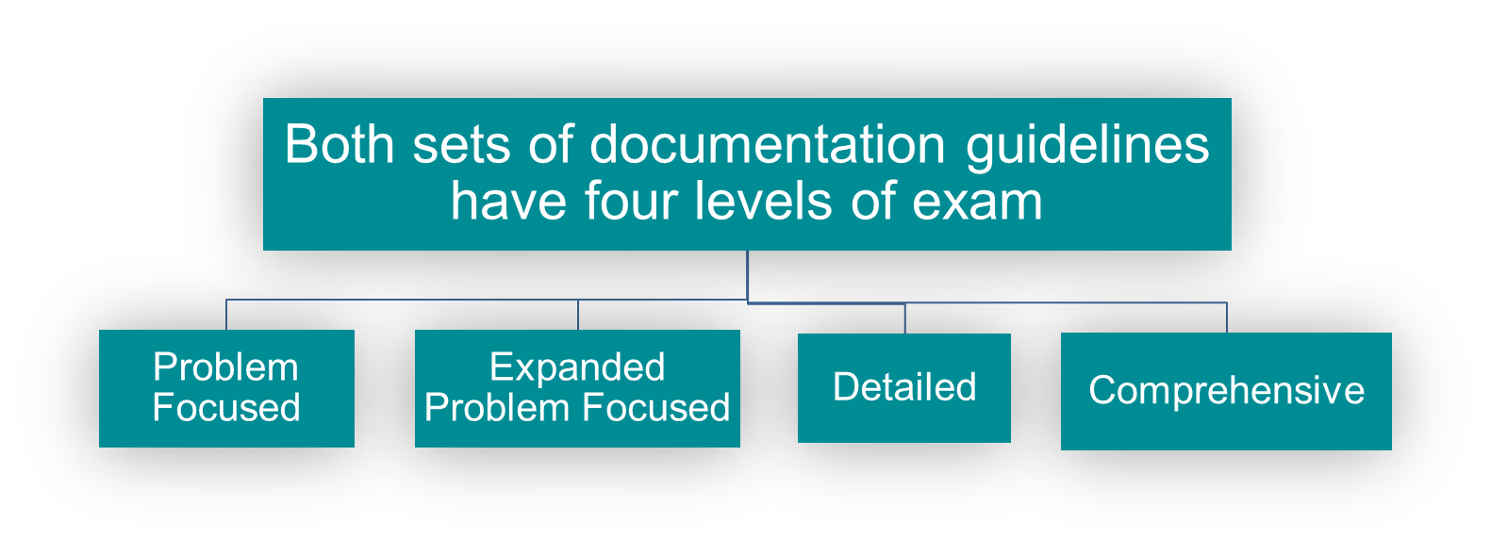
Examination
1995 documentation guidelines:
  Body areas or organ systems
1997 documentation guidelines:
  Bullet points

Slide 81
Levels of Examination (1995)
Level | Description | Components
Problem-Focused | Limited exam of affected body areas or organ systems | 1 body area or organ system
Expanded Problem-Focused | Exam of affected body areas or organ systems & other symptomatic or related organ systems | 2-7 body areas or organ systems
Detailed | Extended exam of affected body areas or organ systems & other symptomatic or related organ systems | 2-7 body areas or organ systems with at least one described in detail
Comprehensive | Complete multi-system exam | 8 or more organ systems *
* Body areas may not be used to support a comprehensive exam

Slide 82
1995 Exam Guidelines
Body Areas
  Head, including face
  Neck
  Chest, including breasts & axillae
  Abdomen
  Genitalia, groin, buttocks
  Back, including spine
  Each extremity
Organ Systems
  Constitutional (3 vital signs, general appearance)
  Eyes
  Ears, nose, mouth and throat
  Cardiovascular
  Respiratory
  Gastrointestinal
  Genitourinary
  Musculoskeletal
  Skin
  Neurologic
  Psychiatric
  Hematologic/lymphatic/immunologic
Note: For purposes of determining the level of exam documented, there is no “mixing and matching” of body areas and organ systems. Only one or the other will be used. Body areas may not be used to support a comprehensive exam.

Slide 83
Expanded Problem Focused vs. Detailed
1995 Guidelines
Both levels require documentation of examination of 2 to 7 organ systems
Detailed exam requires documentation of examination of 2 to 7 organ systems with detailed findings documented about at least one system
  Generally, for one organ system record 3 or more distinct exam findings that require separate actions by the Physician/ACP plus findings for at least one other organ system

Slide 84
Examples of What Constitutes a Detailed Exam 1995 Guidelines
Documentation of the following plus information about at least one additional organ system. (Not an exhaustive list.)
1. Gastrointestinal Soft, nontender, nondistended Positive bowel sounds No hepatosplenomegaly No hernias or masses | 2. Neurological Cranial nerves II – XII intact DTRs intact Sensation intact in all extremities
3. ENT Tympanic membranes intact Nasal mucosa swollen, nasal discharge appears yellow Pharynx appears inflamed | 4. Psychiatric Alert and oriented x 3 Recent memory intact, remote memory unclear Appears very anxious
Note: Not all organ systems will qualify for a detailed exam.
For additional examples, please contact your compliance auditor/educator.

Slide 85
Exam Examples
1995 Guidelines
Expanded Problem Focused | Detailed | Comprehensive
Wt 219 lbs, BP 165/95, pulse 82 Lungs clear Heart regular rate and rhythm 3 Organ Systems with no detail | Wt 219 lbs, BP 165/95, pulse 82 No JVD, no carotid bruits Lungs clear Heart regular rate and rhythm Extremities no edema, distal pulses intact 3 Organ Systems; with detail regarding cardiovascular system | Wt 219 lbs, BP 165/95, pulse 82 Alert and oriented x 3 HEENT benign Lungs clear Heart regular rate and rhythm Abdomen soft, nontender Skin no rashes or lesions 8 Organ Systems

Slide 86
1995 Exam – Let’s Practice
Physical Exam
Constitutional: No acute distress; Temp-97.5°F, Pulse-78 BPM,
Systolic BP-132mmHg, Diastolic BP-89mmHg, SpO2-99%
Respiratory: Lungs clear to auscultation
Cardiovascular: Normal rate & rhythm
Gastrointestinal: Soft, non-tender, non-distended
Integumentary: Warm, intact
Neurologic: Alert & oriented
Psychiatric: Alert & oriented x 3
EXPANDED PROBLEM-FOCUSED EXAM
6 organ systems documented with no detail
** No credit given for Neurologic – duplicate finding in Psychiatric**

Slide 87
1995 Exam – Let’s Practice
Physical Exam
Constitutional: No acute distress; Temp-97.5°F, Pulse-78 BPM,
Systolic BP-132mmHg, Diastolic BP-89mmHg, SpO2-99%
Eyes: PERRLA
Respiratory: Lungs clear to auscultation
Cardiovascular: Normal rate & rhythm
Gastrointestinal: Soft, non-tender, non-distended, no hepatosplenomegaly, no hernias, active bowel sounds
Integumentary: Warm, intact
Psychiatric: Alert & oriented x 3
DETAILED EXAM
7 organ systems documented
with detail in the Gastrointestinal system

Slide 88
1995 Exam – Let’s Practice
Physical Exam
Constitutional: No acute distress; Temp-97.5°F, Pulse-78 BPM,
Systolic BP-132mmHg, Diastolic BP-89mmHg, SpO2-99%
Eyes: PERRLA
Respiratory: Lungs clear to auscultation
Cardiovascular: Normal rate & rhythm, no JVD, no edema
Gastrointestinal: Soft, non-tender, non-distended
Integumentary: Warm, intact
Neurologic: No focal deficits, DTRs intact
Psychiatric: Alert & oriented x 3
COMPREHENSIVE EXAM
8 organ systems documented

Slide 89
1997 Exam Guidelines
One general multi-system exam and ten single organ system or “specialty” exams are available
  General Multi-System
  Cardiovascular
  Ear, Nose & Throat
  Eye
  Genitourinary (Female)
  Genitourinary (Male)
  Hematologic/Lymphatic/Immunologic
Musculoskeletal
Neurological
Psychiatric
Respiratory
Skin
See your handouts for a copy of the General Multi-System exam

Slide 90
1997 Exam
Multi-Specialty vs. Specialty
General Multi-System Exam:
Problem Focused =
1-5 bullets
Expanded Problem Focused =
6-11 bullets
Detailed =
at least 12 bullets in 2 or more
organ systems
Comprehensive =
18 bullets (at least 2 bullets
from each of 9 organ systems)
Specialty Exams:
Problem Focused =
1-5 bullets
Expanded Problem Focused =
6-11 bullets
Detailed =
at least 12 bullets (for eye and
psych exams, at least 9 bullets)
Comprehensive =
every bullet in all shaded boxes
& at least 1 bullet from each
unshaded box

Slide 91
Exam Example
1997 Guidelines
Wt 219 lbs, BP 165/95, pulse 82
No JVD, no carotid bruits
Lungs clear
Heart regular rate and rhythm CV – 1 bullet
Extremities no edema, distal pulses intact
Alert and oriented x 3
Const – 1 bullet
CV – 2 bullets
Resp – 1 bullet
CV – 2 bullets
Psych – 1 bullet
8 bullets = Expanded Problem Focused exam
Using 1995 criteria = Detailed exam

Slide 92
Examination:
Coding and Documentation Risk Areas
The most common risk areas of the exam portion of Physicians/ACPs’ documentation involves insufficient documentation of the number of organ systems or detail within those organ systems required to support the level of service billed including:
  Fewer than 8 organ systems for new office visit codes 99204 and 99205, consult levels 99244 and 99245, initial inpatient care (admissions) codes 99222 and 99223, and initial observation care codes 99219 and 99220
  Documentation of only an expanded problem focused exam (2 to 7 organ systems with no detail) for 99214 and 99233

Slide 93
Time-Based Billing

Slide 94
Time-Based Billing
Time is considered the controlling factor and can be used to determine the E/M code when greater than 50% of the total encounter time is spent in counseling and/or coordination of care
  Outpatient = Face-to-face time with the patient
  Inpatient = Floor or unit time devoted to patient
See your matrix card to determine the total number of minutes associated with various codes
Key elements are irrelevant if you are coding based on time.

Slide 95
Time-Based Billing
To code based on time, you must document the following:
  Total time spent on encounter
  Statement that over half the visit was spent in counseling/coordination of care
  What was discussed, if counseling, OR what was done for coordination of care
Note: Time accumulates for the individual billing Physician/ACP only. Multiple Physicians/ACPs’ time may not be combined for purposes of time-based billing, regardless of relationship (e.g., resident/fellow, ACP)

Slide 96
Time-Based Billing
Counseling includes discussion with the patient regarding:
  Diagnosis, prognosis, treatment options, etc.
  Discussion of psychiatric issues
  Instructions for management and/or follow up
  Diagnostic results, impressions, and/or recommended diagnostic studies

Slide 97
Time-Based Billing
Coordination of care includes:
  Discussion with physicians or ACPs from other practices to coordinate treatment for patient, discussion with hospice or rehab hospital regarding placement, etc.
Coordination of care does NOT include:
  Discussion with the nurses, your supervising physician if you are an ACP, or the residents if you are their teaching/attending physician
  Time spent reviewing old records

Slide 98
Example: Time-Based Billing
New pt c/o new onset depressive episode. Remote h/o major depressive d/o, not requiring tx since 2005. PMH otherwise unremarkable, NKDA. No other complaints. Pt presents with list of anti-depressant medications found online. We reviewed each option in detail r/t potential side effects, and pt desires trial of venlafaxine HCl. Pt also expresses interest in outpt “talk therapy.” Provided list of mental health Physicians/ACPs participating in her insurance plan. Pt to call w/in 2 wks to report impact of rx on mood; RTC 4 wks or sooner if needed. Total of 45 minutes spent with pt, greater than 50% of which was spent in discussion of tx options for depression.
Time-based billing documentation supports 99204
(Key elements alone would support only 99201)

Slide 99
Example: Time-Based Billing
Inpt Consult: Pt with ongoing gross hematuria, weight loss, and sickle cell trait which could be suggestive of an underlying malignancy. Upon exam, patient has fullness in perineal area. Explained how sickle cell trait can be related to renal medullary carcinoma and renal papillary necrosis, both of which can cause gross hematuria. CT w/ contrast was negative. Will obtain a CT urography to better evaluate other causes. Will repeat hgb electrophoresis and order hemolysis labs. Total of 80 minutes spent with pt and floor time, > than 50% of which was spent discussing tx options for unexplained gross hematuria, reviewing labs & CT images.
Time-based billing documentation supports 99254
(Key elements alone would support only 99251)

Slide 100
Onsite Training is Available
If you wish to receive onsite training, please indicate your interest on the Evaluation Form (question #5). Your assigned Auditor/Educator will coordinate the onsite follow-up session.
The onsite session could include:
  Review and discussion of your recent documentation
  Shadowing
  Specialty-specific services
    e.g., preventive services, prenatal visits, common procedures

Slide 101
Putting it All Together:
Choosing a Code Level

Slide 102
Office Visit Codes

Slide 103
New vs. Established Patient
Office Visits
AMA CPT® definition:
A new patient is one who has not received any professional (face-to-face) services from the physician/ qualified health care professional or another physician/ qualified health care professional of the exact same specialty and subspecialty who belongs to the same group practice, within the past three years.¹
¹ CPT 2018, Professional Edition, AMA pg.4

Slide 104
New vs. Established Patient
Office Visits
AMA CPT ® definition:
An established patient is one who has received professional (face-to-face) services from the physician/ qualified health care professional or another physician/ qualified health care professional of the exact same specialty and subspecialty who belongs to the same group practice, within the past three years.¹
The location where the services were provided previously is irrelevant.
¹ CPT 2018, Professional Edition, AMA pg.4

Slide 105
NEW PATIENT OFFICE VISIT CODES
99201-99205 (3 OF 3 KEY ELEMENTS)
CPT Code | History | Exam | Complexity of MDM | Average Time
99201 | HPI = 1 – 3 | 1 organ system | Minimal/ straight-forward | 10 min
99202 | HPI = 1 - 3 ROS = 1 | 2 – 7 organ systems | Minimal/ straight-forward | 20 min
99203 | HPI = 4+ ROS = 2 – 9 PFSH = 1 | 2 – 7 organ systems with one in detail | Low | 30 min
99204 | HPI = 4+ ROS = 10+ PFSH = all 3 | 8+ organ systems | Moderate | 45 min
99205 | HPI = 4+ ROS = 10+ PFSH = all 3 | 8+ organ systems | High | 60 min

Slide 106
ESTABLISHED PATIENT OFFICE VISIT CODES
99211-99215 (2 OF 3 KEY ELEMENTS)
CPT Code | History | Exam |  | Complexity of MDM | Average Time
99211 | NON-MD VISIT (e.g., RN visit). May not require the presence of an MD. MD must review and sign note. |  |  |  | 5 min
99212 | HPI = 1 – 3 | 1 organ system | Minimal/ straight-forward | Minimal/ straight-forward | 10 min
99213 | HPI = 1 - 3 ROS = 1 | 2 – 7 organ systems | Low | Low | 15 min
99214 | HPI = 4+ ROS = 2 - 9 PFSH = 1 | 2 – 7 organ systems with one in detail | Moderate | Moderate | 25 min
99215 | HPI = 4+ ROS = 10+ PFSH = 2 | 8+ organ systems | High | High | 40 min

Slide 107
The Differences Between 99213 and 99214
Key Element | Subcomponent of Key Element | 99213 | 99214
History | History of the present illness | 1 – 3 indicators | 4 + indicators
 | Review of systems | 1 system | 2 – 9 systems
 | Past, family and social history | n/a | 1 of the components
Exam |  | 2 – 7 organ systems | 2 – 7 organ systems with one described in detail
Decision-making complexity (2 of the 3 subcomponents must be documented) | Number of diagnoses or management options | 2 points | 3 points
 | Amount and/or complexity of data | 2 points | 3 points
 | Risk associated with the patient’s condition | Low | Moderate

Slide 108
OFFICE CONSULTATION CODES
99241-99245 (3 OF 3 KEY ELEMENTS)
CPT Code | History | Exam | Complexity of MDM | Average Time
99241 | HPI = 1 - 3 | 1 organ system | Minimal/ straight-forward | 15 min
99242 | HPI = 1 - 3 ROS = 1 | 2 – 7 organ systems | Minimal/ straight-forward | 30 min
99243 | HPI = 4+ ROS = 2 – 9 PFSH = 1 | 2 – 7 organ systems with one in detail | Low | 40 min
99244 | HPI = 4+ ROS = 10+ PFSH = all 3 | 8+ organ systems | Moderate | 60 min
99245 | HPI = 4+ ROS = 10+ PFSH = all 3 | 8+ organ systems | High | 80 min

Slide 109
Inpatient Hospital Visit Codes

Slide 110
2 Midnight Rule (Medicare)
Documentation requirements:
Physician expectation that patient will require medically necessary services for 2 or more midnights
Admission order must be authenticated prior to patient’s discharge (ACPs and Residents may not sign admission orders using their proxy signature authority)
History and Physical must document the intensity, severity and risk indicators, supporting why the patient cannot safely be treated in an outpatient setting
“2 Midnight Rule” overview video available at:
Coding for New Physicians/ACPs - All Documents
Exception: Medicare Inpatient Only (MIO) procedure list is updated annually, and lists services that must be performed as inpatient - even if patient does not stay two midnights

Slide 111
INITIAL HOSPITAL VISIT
99221-99223 (3 OF 3 KEY ELEMENTS)
CPT Code | History | Exam | Complexity of MDM | Average Time
99221 | HPI = 4+ ROS = 2 – 9 PFSH = 1 * | 2 – 7 organ systems with one in detail | Low | 30 min
99222 | HPI = 4+ ROS = 10+ PFSH = all 3 | 8+ organ systems | Moderate | 50 min
99223 | HPI = 4+ ROS = 10+ PFSH = all 3 | 8+ organ systems | High | 70 min
* Medical Staff Rules and Regulations require documentation of the patient’s Past Medical History

Slide 112
SUBSEQUENT HOSPITAL VISITS
99231-99233 (2 OF 3 KEY ELEMENTS)
CPT Code | History | Exam | Complexity of MDM | Average Time
99231 | HPI = 1 – 3 | 1 organ system | Low | 15 min
99232 | HPI = 1 - 3 ROS = 1 | 2 - 7 organ systems | Moderate | 25 min
99233 | HPI = 4+ ROS = 2 - 9 | 2 - 7 organ systems with one in detail | High | 35 min
Notes:
Subsequent hospital visits differ from the initial hospital visits in that they require 2 of the 3 key elements—vs all three for the initial hospital visits.
History: Problem-focused is 1 HPI, Expanded Problem-focused is 1 HPI and 1 ROS, Detailed is as we discussed earlier 4 HPI and 2 ROS.
EXAM-Problem-focused is 1 Organ system, Expanded is 2-7 and Detailed is as we discussed earlier 2-7 in detail.
Consider the patient’s status when choosing subs hosp levels and then 2 of 3 key elements.

Slide 113
SUBSEQUENT HOSPITAL VISITS
99231-99233 (2 OF 3 KEY ELEMENTS)
CPT Code | Patient
99231 | Stable, recovering or improving
99232 | Responding inadequately to therapy or has developed a minor complication
99233 | Unstable or has developed a significant complication or significant new problem

Slide 114
Discharge Day Management Codes
CPT Code | Time | Documentation Required
99238 | Up to 30 minutes | Does not require documentation of time
99239 | > 30 minutes | Requires documentation of the total time spent – not just “more than 30 minutes”
Includes total time spent by Physician/ACP for patient discharge
Includes final exam, discussion with patient and caregivers, preparation of prescriptions and referral forms, documentation in chart and dictation of discharge summary
Physicians/ACPs of the same specialty and group can combine their time to report 99239
Be sure to document the total time spent in the medical record if you are billing 99239
Notes:
Physician/ACP must document the total time spent on the discharge service, not just that >30 minutes was spent.

Slide 115
INPATIENT CONSULTATION CODES
99251-99255 (3 OF 3 KEY ELEMENTS)
CPT Code | History | Exam | Complexity of MDM | Average Time
99251 | HPI = 1 – 3 | 1 organ system | Minimal/ straight-forward | 20 min
99252 | HPI = 1 - 3 ROS = 1 | 2 – 7 organ systems | Minimal/ straight-forward | 40 min
99253 | HPI = 4+ ROS = 2 – 9 PFSH = 1 | 2 – 7 organ systems with one in detail | Low | 55 min
99254 | HPI = 4+ ROS = 10+ PFSH = all 3 | 8+ organ systems | Moderate | 80 min
99255 | HPI = 4+ ROS = 10+ PFSH = all 3 | 8+ organ systems | High | 110 min

Slide 116
Observation Care Codes

Slide 117
Observation Care Codes
Documentation must indicate the patient is in “observation status”
The series of observation care codes used depends on the number of calendar days the patient is in observation status and may be affected by the amount of time the patient spent in observation

Slide 118
Observation Care Codes
Timing Of Care | 1 calendar day < 8 hours | 1 calendar day 8+ hours | 2 calendar days | 3 or more calendar days
Report | 99218 – 99220 only | 99234 – 99236 only | 1st day: 99218 -99220 2nd day: 99217 | 1st day: 99218 – 99220 2nd + days: 99224 – 99226 Last day: 99217

Slide 119
INITIAL OBSERVATION CARE CODES
99218-99220 (3 OF 3 KEY ELEMENTS)
CPT Code | History | Exam | Complexity of MDM | Average Time
99218 | HPI = 4+ ROS = 2 – 9 PFSH = 1 | 2 – 7 organ systems with one in detail | Low | 30 min
99219 | HPI = 4+ ROS = 10+ PFSH = all 3 | 8 organ systems | Moderate | 50 min
99220 | HPI = 4+ ROS = 10+ PFSH = all 3 | 8 organ systems | High | 70 min

Slide 120
SUBSEQUENT OBSERVATION CARE CODES
99224-99226 (2 OF 3 KEY ELEMENTS)
CPT Code | History | Exam | Complexity of MDM | Average Time
99224 | HPI = 1 – 3 | 1 organ system | Low | 15 min
99225 | HPI = 1 - 3 ROS = 1 | 2 - 7 organ systems | Moderate | 25 min
99226 | HPI = 4+ ROS = 2 – 9 | 2 – 7 organ systems with one in detail | High | 35 min

Slide 121
Observation Care Discharge
For patients who are in observation status for two or more calendar days, the last day should be reported using:
99217 Observation care discharge

Slide 122
Same Day Observation Care Codes
99234-99236 (3 of 3 key elements)
CPT Code | History | Exam | Complexity of MDM | Average Time
99234 | HPI = 4+ ROS = 2 – 9 PFSH = 1 | 2 – 7 organ systems with one in detail | Low | 40 min
99235 | HPI = 4+ ROS = 10+ PFSH = all 3 | 8 organ systems | Moderate | 50 min
99236 | HPI = 4+ ROS = 10+ PFSH = all 3 | 8 organ systems | High | 55 min

Slide 123
Advanced Clinical
Practitioners (ACPs)
And Split/Shared Services

Slide 124
Split/Shared Visits
A split/shared visit is defined by Medicare as:
  “A medically necessary encounter with a patient where the physician and a qualified non-physician practitioner each personally perform a substantive portion of an E/M visit, face-to-face with the same patient, on the same date of service”

Slide 125
Split/Shared Visits
A substantive portion of an E/M visit involves documentation of at least one of the three key components (history, exam, or medical decision-making)
The physician and the qualified ACP must be in the same group practice or be employed by the same employer

Slide 126
Split/Shared Visits
Split/shared visits are allowed in the following settings:
  INPATIENT SETTING
  OUTPATIENT HOSPITAL DEPARTMENTS
  PROVIDER BASED CLINICS
Split/shared billing is not allowed in the free-standing office setting

Slide 127
Split/Shared Visits
The following services may not be split/shared:
  New Patient Office Visits in a free-standing medical practice
    Note that split/shared new patient office visits ARE allowed in a hospital outpatient department or Provider-based clinic
  Critical Care Services
  IPPE (Initial Preventive Physical Exam)
  Procedures
  Nursing Facility Services
  Home Care Services
  Domiciliary Care Services
It is important to note that Medicare’s prohibition against split/shared consult services goes away with Medicare’s elimination of the CPT consult codes

Slide 128
Documentation Requirements for Split/Shared Visits
The physician and the ACP must both see the patient face-to-face and perform at least one of the three key elements of the E/M service on the same day
Both the ACP and physician should document their individual portion of the service in the medical record
  It would not be appropriate for the physician to copy/paste the ACP’s documentation
A combination of the documentation by both Physicians/ACPs can be used to support the E/M code billed

Slide 129
Documentation Requirements for Split/Shared Visits
If the physician only reviews and co-signs the chart without performing a portion of the E/M service, it is inappropriate to bill a “split/shared visit”
The ACP should bill the service directly under their name and provider number if the physician only co-signs the note
A physician’s co-signature or brief attestation that he/she “saw the patient; examined the patient; agree with the ACP” is not sufficient evidence of a face-to-face visit and participation in the patient’s care

Slide 130

Split/Shared Visits
Services reported based on time may not be split/shared
  Multiple Physicians/ACPs’ time may not be combined for purposes of time-based billing, regardless of their relationship (e.g., MD/ACP)
Exception: Medicare permits discharge day management code 99239 to be split/shared

Slide 131
Split/Shared Visits –
Non-Medicare Patients
In the inpatient setting, an ACP can see a non-Medicare patient and document an E/M encounter and if the physician reviews and co-signs the note, the service can be billed under the physician’s name and provider number
Exception: BCBS of North Carolina and NC Medicaid require that any service provided by an ACP be reported directly by the ACP

Slide 132
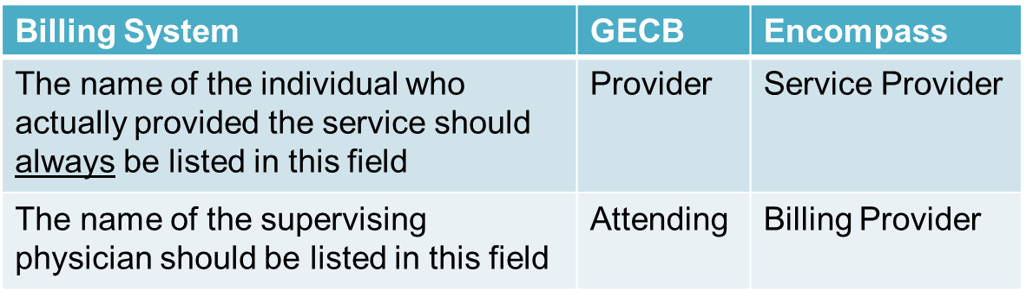
Billing for ACP Services
It is critical that the work performed by ACPs is captured accurately in the billing system
  If an ACP participates in a service their name must be listed as the service provider
The billing system determines which name appears on the claim based on the payer
Notes:
Atrium Health is currently transitioning from GECB(IDX) to Encompass.

Slide 133
Billing for ACP Services
When is the ACP’s name required to be entered in the ‘Provider’ or ‘Service Provider’ field?
  Any time the ACP performs any portion of an E/M service beyond gathering the Review of Systems and Past/Family/Social Histories
    History of Present Illness
    Physical Examination
    Medical Decision Making
    Counseling and/or coordination of care
  Any time the ACP performs a non-E/M service (i.e., interpretation of an EKG or x-ray, wound repair, or other surgical procedure)

Slide 134
Split/Shared Visits –
Tracking Modifier Information
Unique to Atrium Health, an internal tracking modifier – F2F, has been created to indicate physician involvement in Evaluation/Management services
For practices in which physicians receive compensation based on RVUs, this modifier allows the credit for participation in the service and reimbursement calculation to be made by the Atrium Health Finance Department

Slide 135
Split/Shared Visits –
Tracking Modifier Information
The ACP is responsible for reporting the level of service during the split/shared visit
  This ensures the supervising physician listed in the ‘order details’ is the physician who participated in the face-to-face visit
The tracking modifier field is located on the order entry screen when the level of service order is modified

Slide 136
Provider Charge Workflow (PCW)
PCW allows Physicians/ACPs to capture their hospital charges electronically
The ACP places the order for the charge and indicates the supervising physician on the order
The physician cannot place the order and indicate that the service was shared with an ACP
Notes:
IM Bills allows Physicians/ACPs to capture their hospital charges electronically. Physician/ACP information must be entered into this application correctly to ensure claims accuracy. When the physician submits a shared charge, they need to enter the ACP’s name in the Comment field. When the ACP submits the charge, they need to enter their own name in the MD field and enter the physician’s name in the Supervising Physician field.

Slide 137
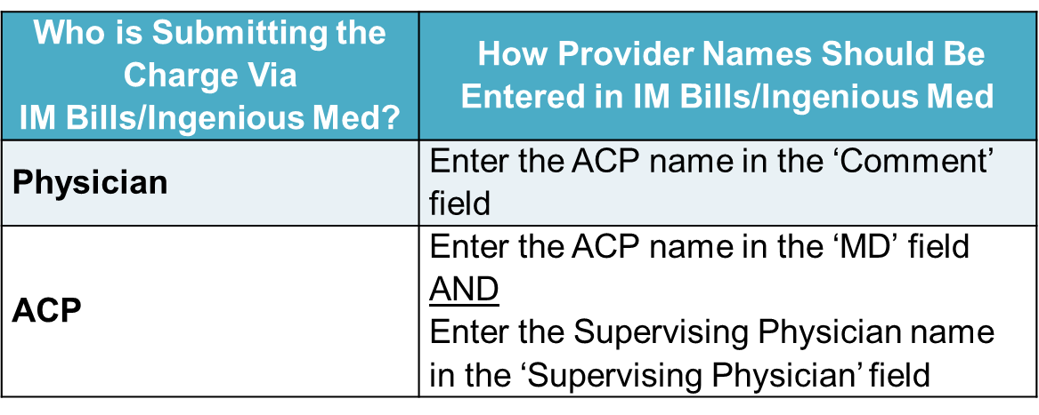
IM Bills/Ingenious Med
IM Bills allows Physicians/ACPs to capture their hospital charges electronically
Physician/ACP information must be entered into this application correctly to ensure claims accuracy
Notes:
IM Bills allows Physicians/ACPs to capture their hospital charges electronically. Physician/ACP information must be entered into this application correctly to ensure claims accuracy. When the physician submits a shared charge, they need to enter the ACP’s name in the Comment field. When the ACP submits the charge, they need to enter their own name in the MD field and enter the physician’s name in the Supervising Physician field.

Slide 138
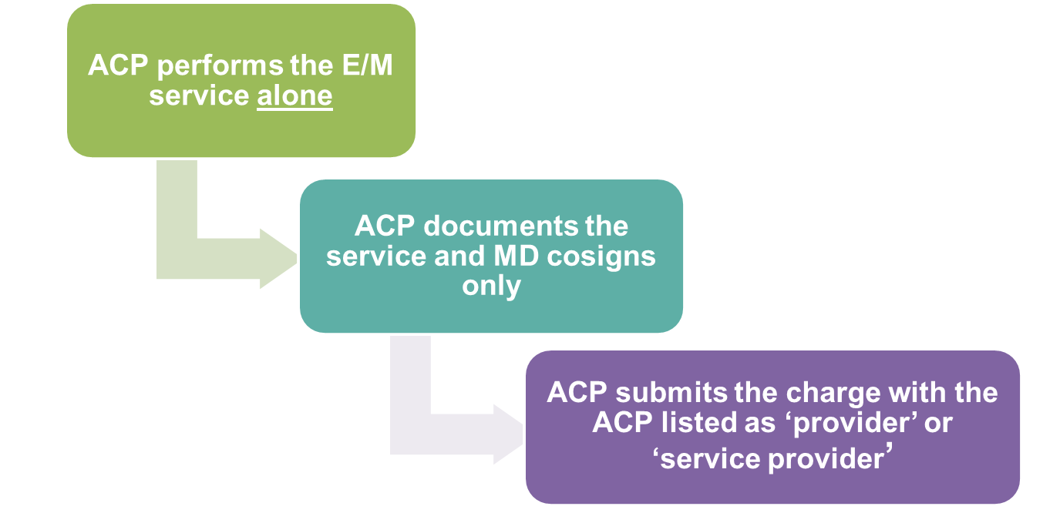
Billing for ACP Services
Notes:
Scenario – ACP performs the service alone

Slide 139
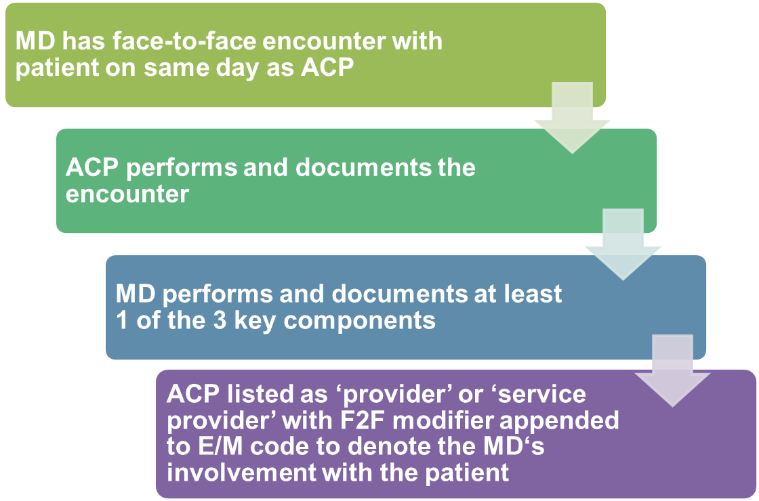
Billing for ACP Services
Notes:
Scenario – ACP and MD both see pt; MD documents 1 key component
** Not all practices use the F2F modifier to assign internal rvus

Slide 140
Other Coding and
Documentation Topics

Slide 141
Critical Care Services
A coding job aid is available on eLink for your reference

Slide 142
Critical Care Documentation
To bill the critical care codes, the documentation must support the following:
  The patient’s condition must be life threatening or he or she must be in imminent danger of organ failure
  High complexity decision-making
The following must be documented:
  Condition of the patient
  Details of the assessment, treatment plan and any other services provided
  Amount of time spent providing critical care

Slide 143
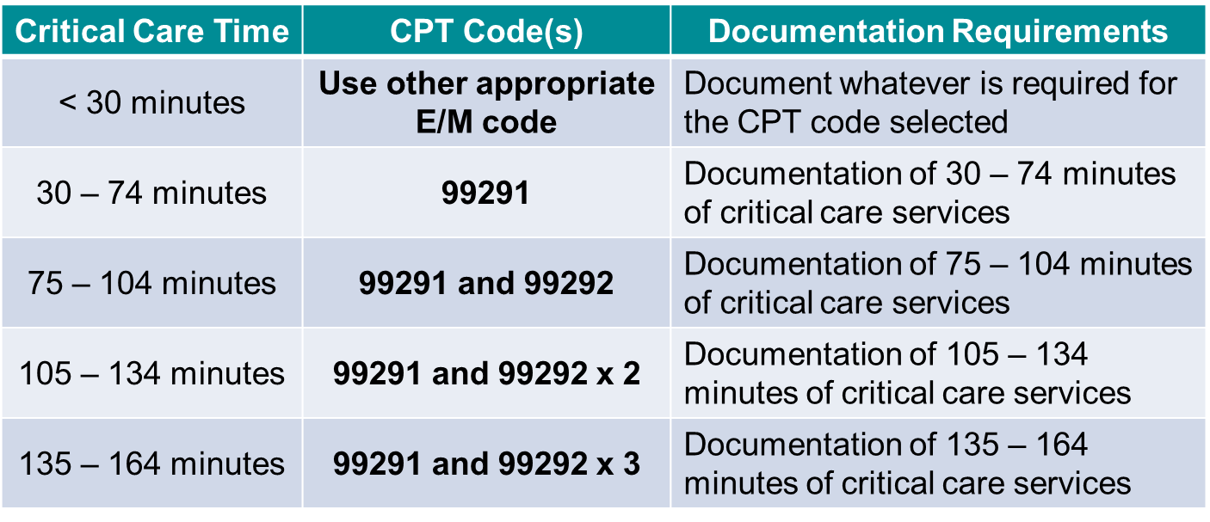
Critical Care Codes
Please ask for your billing staff’s assistance in determining the correct codes for time spent beyond 164 minutes.

Slide 144
Critical Care Documentation
Using the codes:
  99291 cannot be reported more than once per date of service by physicians of the same specialty from the same practice
  Time spent treating the patient does not have to be continuous
  Critical care time may not be split/shared between an MD and an ACP
  Critical care time performed by a resident may not be billed
Simply noting that the patient’s condition is “unstable” does not support use of the code(s)
Not all visits to a patient in the ICU qualify as Critical Care services
If you provide a service that can be billed using another CPT code during the critical care encounter, you must subtract the time spent performing that service from the time used to determine the critical care code(s)

Slide 145
Consultations

Slide 146
Consult vs. Transfer of Care
A consultation is defined as:
  A request for opinion or advice regarding evaluation and/or management of a specific problem
  OR
  An initial encounter conducted to determine whether to accept responsibility for ongoing management of the patient’s entire care or the care of a specific condition or problem
Must be provided at the request of another healthcare Physician/ACP or appropriate source
  Documentation should specify who requested the consultation
Notes:
Since January 1, 2019, Medicare no longer recognizes consult codes. In order to accommodate this change, internal codes are used to report consults. The billing system has edits built-in which map the internal codes to the appropriate E/M code based on the payer. For Medicare patients, office consults (I1701 – I1715) map to new and established office visits; and hospital consults (I1721 – I1725) map to initial and subsequent hospital visits.

Slide 147
Consult vs. Transfer of Care
Transfer of care is defined as:
  The transfer of complete or specific care of a patient from one physician to another physician or healthcare provider
Consultation codes should not be reported when a Physician/ACP has agreed to accept responsibility for care of a patient before the initial evaluation
If a consultation is provided, a written report documenting your findings must be provided to the requesting Physician/ACP as a:
    Part of a common (shared) medical record,
    Separate letter, or
    Copy of consultation report via cc:

Slide 148
EMR Cautions

Slide 149
EMR Cautions
The Atrium Health Physician IT Advisory Committee (PITAC) has released a “document integrity” statement highlighting potential risks associated with the use of EMR systems including Canopy
Utilization of copy/paste, copy forward, macro functionality/tools and voice recognition software in an EMR can be great time savers, but they must be used with caution
Be sure to carefully review and update each note or report when these EMR tools are used so that the documentation accurately reflects all the services performed for that day’s encounter
Notes:
For example, copying forward diagnoses that do not impact the presenting problem(s) for the current visit can inappropriately result in the coding of conditions that were previously treated and no longer exist.

Slide 150
Voice Recognition Technology
Exercise caution when using voice recognition technology (e.g., “Dragon”)
Voice-dictated notes are held to the same standards as those generated by any other means
Physicians/ACPs are responsible for proofreading all elements of their note to ensure accuracy
The use of phrases (disclaimers) meant to excuse a Physician/ACP’s responsibility for errors in the medical record by attributing these to technological problems provide no protection from consequences of documentation errors

Slide 151
Voice Recognition Technology
Examples of “disclaimers” seen in EMR
This note was dictated with Dragon voice recognition technology and may contain erroneous phrases or words.
There may be some typographical errors generated by the transcription software that may have been missed despite a reasonable effort to identify and correct them. Please contact me if further clarification is needed.

Slide 152
Template Inconsistencies
History of Present Illness 29 yo patient presents to the clinic today with congestion and cough since last week. Patient reports that she has been taking Advil and Robitussin with no relief. Patient denies shortness of breath or chest pain. Review of Systems Constitutional: No Fever HEENT: No sore throat Respiratory: No cough Lymph: No swollen glands
Template Use
Templates are an effective mechanism for documenting quantitative data such as a patient’s ROS (Review of Systems). However, failure to update a template that is pre-populated with, for example, negative responses, when the patient has a contradictory positive response to a question as recorded in the HPI (History of Present Illness) section, or failure to remove a negative response when the question was never asked, creates an erroneous record entry and can potentially lead to improper patient care or payment.

Slide 153
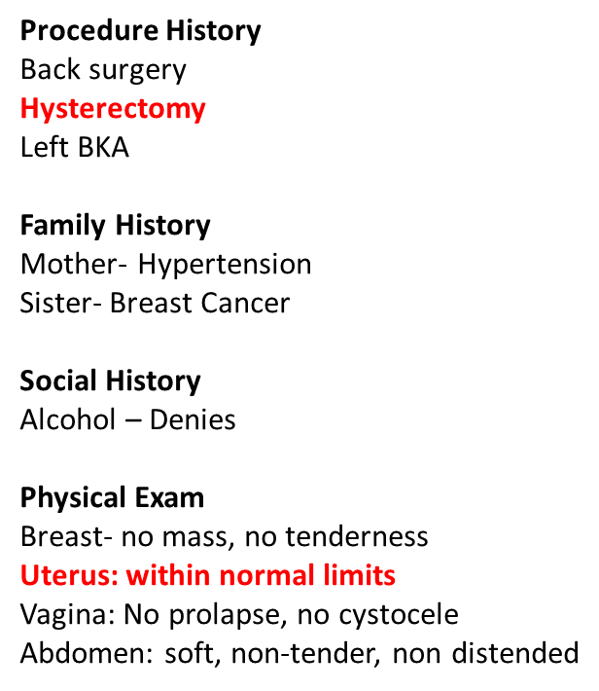
Template Inconsistencies
When using a pre-completed note template or macro (i.e., charting by exception), the Physician/ACP must remember to:
Update any item when the response differs from the pre-loaded response (e.g., from negative to positive, or normal to abnormal);
Remove any item(s) not performed.

Slide 154
Boilerplate & Blanket Statements
Assessment and Plan
Diagnosis: Pinkeye
Prescription written for gentamicin ophthalmic. Encouraged to call the office or return if worse or no improvement.
More than ½ of a 60 minute total encounter time was spent in counseling and coordination of care.
It is unlikely that a 60 minute visit was required for treatment of conjunctivitis
When selecting an E/M code based on time, the documentation must detail what was discussed if counseling the patient, or what services were done for coordination of care
Such statements should NOT be prepopulated on every note

Slide 155
Copy Paste
07/14 Impression and plan
Will order a CT scan of the abdomen, CBC labs and CRP. continue Zofran.
07/15 Impression and plan
Will order a CT scan of the abdomen, CBC labs and CRP. continue Zofran.
07/16 Impression and plan
Will order a CT scan of the abdomen, CBC labs and CRP. continue Zofran.
Every note should reflect that day’s encounter with the patient. It is unlikely that the impression and plan would be exactly the same for consecutive visits. The Physician/ACP will only receive credit once for the above statements.
Notes:
Each of these impressions and plans were copy/pasted from the previous day’s note.

Slide 156
Copy Forward
Chief Complaint
Follow-up visit – abdominal pain
History of the present illness
29 year old male presents with GI problems. He was seen previously by another practice and was diagnosed with IBS. I reviewed the report of his last colonoscopy and it was without findings. His grandfather had colon cancer. He is not a smoker. He is employed with Atrium Health and is happy with his job. He is married and has 15 kids. His last labs revealed a GGT of 128.
The HPI portion of the note should capture the patient’s experience in their own words. This should not be pulled through and copied from a previous note.
Unless the patient is unable to communicate, your HPI documentation should reflect what has been going on with the patient from the previous encounter to the current encounter.
Notes:
Each of these impressions and plans were copy/pasted from the previous day’s note.

Slide 157
Specific Medical Documentation Matters
  Ensure that the documentation in the patient’s medical record is specific
  Statements such as “failed outpatient therapy, admit for spinal fusion” are simply not sufficient evidence of medical necessity for the admission of the surgery

Slide 158
Medicare Signature
Requirements

Slide 159
Medicare Signature Requirements
Medicare requires that services provided or ordered be authenticated by the author. There are two acceptable methods of authentication:
  Handwritten signature
  Electronic signature
Rubber stamp signatures are not acceptable

Slide 160
Timeliness of Documentation

Slide 161
Timeliness of Documentation
Service | Best Practice | Minimum Standard
Outpatient – Office
All encounters | Same day | 3 business days
Inpatient/ ED/ Urgent Care
H&P | Same shift | 24 hours
Discharge summary | Same shift | 24 hours
Progress notes | Same shift | 24 hours
Consults | Same shift | 24 hours
ED/Urgent notes | Same shift | 24 hours
Procedure/OP notes | At completion | At completion
Attending co-signature | Same shift | 48 hours
The Medical Records Standards can be found on PhysicianConnect/Education/Coding & Documentation

Slide 162
Timeliness of Documentation
Effect on audit -
Documentation not completed within 7 calendar days from the date of service will result in a 100 point deduction
Effect on revenue -
After 14 calendar days, an undocumented service is no longer billable

Slide 163
Atrium Health Medical Group
Medical Records Standards
Physicians/ACPs need to ensure that their documentation of care for our patients is accurate, complete, and available for clinical and financial use by others within a reasonable timeframe
Documentation of all patient encounters the same day as the visit is ideal, and should be the goal of every Physician/ACP
Physician/ACP notes must be authenticated (signed, not just saved) in order to be visible to others
Documentation should be formatted in a manner which allows a Physician/ACP to rapidly locate an assessment and plan without scrolling through multiple pages of imported data
Some practices may impose a more rigid standard based on their specialty and/or operational needs

Slide 164
Scribes

Slide 165
Definition of a Scribe
A scribe is an individual who is present during the Physician/ACP’s performance of a clinical service and who documents everything said during the course of the service
“A human tape recorder”
Before engaging the services of a scribe, it is imperative that you become familiar with the Scribe Policy
Visit PhysicianConnect > Education > Coding & Documentation > Scribe Policy
and watch the video at PhysicianConnect > Education > Coding & Documentation > eLink > Coding for New Physicians/ACPs > 14.Scribes

Slide 166
Role of a Scribe
A scribe may not interject their own opinions or observations regardless of their background or clinical training
A scribe may collect the Review of Systems (ROS) and Past, Family and Social History (PFSH) but otherwise should not take part in the service
Other than collecting and recording the ROS and PFSH, any entries made in the record by a scribe should only be made upon dictation by the physician or ACP at the time of service
NOTE: Although Medicare and other payers may permit residents and medical students to serve as scribes, the Atrium Health scribe policy does not allow residents, interns, fellows, or medical students to act as scribes when on active rotation

Slide 167
Documentation Required By the Scribe
The scribe must record a personal, dated note that:
  Identifies the individual as the scribe of the service
  Attests that the notes are recorded contemporaneously in the presence of the physician or ACP performing the services
  Identifies the physician or ACP performing the service
An example of acceptable scribe documentation follows:
  “I, scribe’s name, am acting as scribe
  for Physician/ACP’s name.”

Slide 168
Documentation Required By the
Physician or ACP
The billing Physician/ACP is ultimately responsible for all documentation and must verify that the scribe’s entry accurately reflects the service provided
The Physician/ACP’s documentation should contain the following statement followed by his or her signature:
  “I have reviewed the above documentation for accuracy and completeness and I agree with the above documentation.”

Slide 169
Scribes and the Electronic Medical Record (EMR)
Scribes must log into an EMR using their own log-in and password information
  It is not appropriate for the Physician/ACP to log in to the EMR and then allow the scribe access to the system
Scribe language has been built into Canopy

Slide 170
Diagnosis Coding

Slide 171
The Importance of Diagnosis Coding
Diagnosis codes should support the medical necessity for the service provided
Diagnosis codes selected for billing purposes should always be supported by documentation in the patient’s medical record
Code assignment is not based on clinical criteria used by the Physician/ACP to establish the diagnosis but by Physician/ACP’s statement that the condition exists
  The Physician/ACP’s statement that the patient has a condition is sufficient
Incorrect diagnosis coding can have a direct impact on compliance as well as revenue

Slide 172
Impact of Documentation on Diagnosis Coding (Pro Fee Coding)
Currently, physician (pro fee) services are paid based on the fee associated with the CPT/HCPCS code reported while the diagnosis code typically is used to convey the medical need for a service
With the introduction of Hierarchical Condition Categories (HCC), developed for Risk Adjustment payment models where health cost expenditures will be predicted based on the patient demographics and health status, diagnosis code(s) need to capture, now more than ever before, the acuity, severity and chronicity of patient conditions
For more information regarding HCC, please visit the HCC website on PhysicianConnect:
http://physicianconnect.carolinas.org/HCC

Slide 173
Impact of Documentation on Diagnosis Coding (Pro Fee Coding)
Risk adjustment data is obtained from diagnosis codes reported via claims in all healthcare settings such as inpatient, outpatient facility, and physician office).
Report all diagnosis codes you are currently treating or managing to the highest level of specificity known during each patient encounter.
Diagnosis codes are grouped into Hierarchical Condition Categories (HCCs)
HCCs reset each calendar year, so it is extremely important to document and code each comorbidity that is evaluated by you every calendar year.

Slide 174
General Diagnosis Coding Guidelines
Since a coder (or physician) may only code what is available in the Physician/ACP’s documentation, it is important for Physicians/ACPs to keep the following in mind when documenting (and coding) a patient’s encounter
  Document (and code) all diagnoses that directly impact the treatment plan for the presenting problem
    “Chronic diseases treated on an ongoing basis may be coded and reported as many times as the patient receives treatment and care for the condition(s)”
    Current diagnoses being managed by the billing Physician/ACP should be documented even when a patient is presenting for his/her annual wellness visit
      (Note: The inclusion of these diagnoses does not, by default, mean that a preventive split visit should be billed. Only when a significant and separately identifiable E/M visit is performed should an E/M visit also be reported)

Slide 175
General Diagnosis Coding Guidelines
Document (and code) conditions to the highest degree of certainty known for each encounter/visit
  When a diagnosis has not yet been confirmed/established, document what is known
    e.g., patient’s signs and symptoms, abnormal test results, etc.
  In the ambulatory setting, a coder may not code a diagnosis listed as “probable”, “suspected”, “rule out”, etc.
    a medical record entry by the Physician/ACP of “Probable Angina” when the patient presented to the practice with chest pain, would likely be coded as “Chest Pain”

Slide 176
General Diagnosis Coding Guidelines
Ensure your documentation includes all the pertinent details known about a health condition since insufficient clinical information can result in the assignment of an unspecified code
Consider the following when documenting your note:
  Anatomical location, including laterality
  Severity (e.g., acute, chronic, controlled, uncontrolled, stage, etc.)
  Timing (e.g., continuous, intermittent, etc.)
  Associated conditions
  Contributing factors
  Comorbidities
  Cause and effect relationship (e.g., due to hypertension)
  Agent and/or organism
  Depth/stage for wounds and ulcers
  Complications/manifestations
  Trimester of pregnancy (unless the pregnancy is incidental to the encounter)
  Episode of care (e.g., initial, subsequent, sequela) – Injuries and Poisoning
Notes:
Location - specific extremity, cranial nerve, part of colon, laterality
Severity - asthma, depression, dysplasia
Timing – acute vs chronic
associated conditions -
contributing factors -
Comorbidities -
Cause/effect – “with,” “due to” – hypertension with heart disease is coded as hypertensive heart disease
Agent/organism – pneumonia due to group B strep
Depth/stage – chronic kidney disease, pressure ulcers
Complications/manifestations – dm w/neurological complications
Pregnancy trimester –
Episode of care –

Slide 177
General Diagnosis Coding Guidelines
Document (and code) any factors that may influence the patient’s health status and/or treatment
  Tobacco use, Alcohol use
  Long term, current use of insulin
  History of organ transplant – specify organ
  Presence of device – specify device (e.g., heart assist device)
  Acquired absence of digit or limb – specify site (e.g., history of below knee amputation)
  Late effect, sequelae (e.g., hemiplegia following a stroke)
  Remission status

Slide 178
General Diagnosis Coding Guidelines
Review and edit information copied/pasted from a previous patient encounter and include only the information that is pertinent to the decision making for the current encounter
Copying forward diagnoses that do not impact the presenting problem(s) for the current visit can inappropriately result in the coding of a diagnosis/ condition that was previously treated and no longer exists

Slide 179
General Diagnosis Coding Guidelines
Common chronic conditions and the documentation requirements for accurate ICD-10-CM code assignment
Asthma
  Severity – document asthma severity as either intermittent, mild persistent, moderate persistent or severe persistent
  Type – exercise induced or cough variant as other types of asthma; documentation should specify type
  Acute exacerbation – documentation should state if the asthma is in acute exacerbation
  Status asthmaticus – is defined as an acute exacerbation of asthma that remains unresponsive to initial treatment with bronchodilators
  Infection – a superimposed infection may be present; this should clearly be documented by the Physician/ACP

Slide 180
General Diagnosis Coding Guidelines
Common chronic conditions and the documentation requirements for accurate ICD-10-CM code assignment
Hypertension
  Primary or secondary – Secondary hypertension is due to an underlying condition. Two codes are required to report secondary hypertension, one to identify the underlying etiology and one from category I15 Secondary hypertension
  Controlled/uncontrolled – Describe the status of hypertension and do not change the code assignment. The correct code for these terms describing hypertension is I10 Essential (primary) hypertension
  Transient – A temporary elevation of blood pressure that is not a true diagnosis of hypertension. Assign code R03.0 elevated blood pressure reading without a diagnosis of hypertension

Slide 181
General Diagnosis Coding Guidelines
Hypertension (continued)
  Complications – Document all complications showing the cause and effect relationship between the two conditions (i.e. due to hypertension, hypertensive, caused by hypertension). When hypertension and chronic kidney disease appear together, a cause and effect relationship is assumed in ICD-10. The following coding guidance applies to hypertensive complications:
    I11 Hypertensive heart disease, use additional code from category I50 Heart Failure if present
    I12 hypertensive chronic kidney disease, use additional code from category I50 Heart Failure if present and use additional code from category N18 Chronic Kidney Disease to identify the stage
    I60 – I69 Hypertensive cerebrovascular disease, code also I10 Essential (Primary) Hypertension
    H35.0 Hypertensive retinopathy, code also I10 Essential (Primary) Hypertension

Slide 182
General Diagnosis Coding Guidelines
Common chronic conditions and the documentation requirements for accurate ICD-10-CM code assignment
Diabetes mellitus (DM)
  Type – Physicians/ACPs must document the type of diabetes in ICD-10-CM:
    E08 Diabetes mellitus due to an underlying condition, code first the underlying condition such as, congenital rubella, Cushing’s syndrome, pancreatitis, etc.
    E09 Drug or chemical induced diabetes mellitus, code first poisoning due to drug or toxin, if applicable. Use additional code for adverse effect, if applicable, to identify drug
    E10 Type 1 diabetes mellitus, that due to pancreatic islet B cell destruction. Also known as “juvenile diabetes”
    E11 Type 2 diabetes mellitus, use for diabetes not otherwise specified
    E13 Other specified diabetes mellitus, includes that due to genetic defects and secondary diabetes not classified elsewhere

Slide 183
General Diagnosis Coding Guidelines
Diabetes mellitus (DM) (continued)
  Body system affected – Diabetes may affect multiple body systems. Physicians/ACPs should document each body system in which diabetes has caused complications. Apply as many diabetes codes as needed to fully describe each body system/manifestation documented
  Complications affecting that body system – Physicians/ACPs must continue to document the cause and effect relationship between diabetes and any body systems affected by the condition. Some examples include: diabetes with neuropathy, diabetic retinopathy, and nephropathy due to diabetes
  Insulin use – Document all treatment aimed at diabetes and/or its complications. If insulin is used to treat the patient long term, then apply code Z79.4 (long term, current use of insulin)

Slide 184
General Diagnosis Coding Guidelines
Example:
Osteoporosis
  With current pathological fracture (M80)
    Age related (M80.0)
      Shoulder (M80.01)
        Right (M80.011)
        Left (M80.012)
      Humerus (M80.02)
        Right (M80.021)
        Left (M80.022)
      Lower Leg (M80.06)
        Right (M80.061)
        Left (M80.062)
Appropriate 7th digit is added to each of these codes
A | Initial encounter for fracture
D | Subsequent encounter for fracture with routine healing
G | Subsequent encounter for fracture with delayed healing
K | Subsequent encounter for fracture with nonunion
P | Subsequent encounter for fracture with malunion
S | Sequela

Slide 185
Who Codes What and Why
Facility/Inpatient coding reflects all diagnoses and procedures associated with the entire episode of care
Codes assigned by corporate division coders
Code assignment based on physician documentation
  Unlimited number of secondary diagnoses and used for:
    Severity of Illness and Risk of Mortality
    Value Based Purchasing
    Patient Safety Indicators
    DRG/reimbursement
Professional Fee/Inpatient coding reflects the physician work for each daily encounter with associated diagnoses
Codes assigned by:
  Physicians based on interpretation of level of service, OR
  Centralized coders based on operative reports or procedure notes
Diagnosis codes used to support Medical Necessity
CPT codes used for reimbursement
Medical Office coding reflects physician work for each appointment
Codes assigned by physicians
Diagnosis codes used to support Medical Necessity
CPT codes used for reimbursement
Notes:
Facility and professional coders follow different guidelines. Facility coders use all diagnoses associated with an episode of care, whether confirmed or suspected. Professional coders can only use confirmed diagnoses and signs/symptoms.
There may be times when you will be queried by the HIM coders for additional detail for DRG code calculation. Although it may appear that you are receiving duplicative information or contradictory information, the HIM coders may require more detail for DRG coding than those on the professional billing side.

Slide 186
Transmittal 540
“Related” Claims

Slide 187
“Related” Claims
Allows the Medicare Administrative Contractor (MAC) and Zone Program Integrity Contractors (ZPIC) to have the discretion to deny other “related” claims submitted before or after the claim in question. If documentation associated with one claim can be used to validate another claim, those claims may be considered “related.”
Example:
When the Part A inpatient surgical claim is denied as not reasonable and necessary, the MAC may recoup the surgeon’s reimbursement for Part B services. For services where the patient’s History and Physical, physician progress notes, or other hospital record documentation does not support the medical necessity for performing the procedure, postpayment recoupment may occur for the performing physician’s Part B service.

Slide 188
Are You Involved in
Research?

Slide 189
Research
If you currently participate in research or are interested in participating in research:
Contact the Office of Clinical and Translational Research (OCTR) at Atrium Health
704-355-0642

Slide 190
Federal Regulations’ Definition of “Research”
A systematic investigation, including research development, testing and evaluation designed to develop or contribute to generalizable knowledge
Studies that involve:
  Patient interviews
  Follow-up contact of patients to determine the effectiveness of a program or a treatment, including mailed questionnaires
  Chart review and analysis of computer-stored clinical and administrative data to assess quality of care, and
  Randomized trials of experimental drugs, devices, and procedures
45 CFR 46.102(d)
Notes:
Marketing surveys and surveys to assess patient satisfaction do not require IRB review and approval because contracts with member groups specifically allow members to be contacted without such approval and because these surveys do not contribute to generalizable knowledge.
Surveys of utilization and quality of care do not require IRB review and approval if the purpose of obtaining the information is to guide marketing decisions and to help make decisions about how to improve the quality of care.

Slide 191
Federal Regulations and “Research”
If information from a project will be published in a scientific journal or presented at a scientific meeting, the project is considered research by the federal definition
Any project that involves randomization of members to different intervention risk must be reviewed by the IRB even if the project is a quality improvement project since random assignment is part of an experiment (by definition) and thus research

Slide 192
Questions?

Slide 193
Contacts
CHARLOTTE METRO
Carolee Bryan, CPC, CEMC (704) 512-5937
Gina Barrett, CPC, CEMC (704) 512-5938
Cathy Serfass, CPC, CEMC (704) 512-5908
Vanessa Coles, CPC, CEMC (704) 512-5944
Mary Morrison, CPC, CEMC (704) 512-5916
Meleah Oliver, CPC, CEMC, CMA (704) 403-4776

Slide 194
Contacts
CHARLOTTE METRO
Martha Forrest, CPC, CEMC, CDEO (704) 403-4736
Stephanie Nowak, CPC, CEMC, CDEO (704) 403-4751
Erica Woolsey, CPC, CEMC (980) 323-4144
Roberta Siler, CPC (704) 403-4731
NEW HANOVER, COLUMBUS, and SCOTLAND REGIONS
Gloria Bright, CPC, CPMA, CEMC (910) 667-3752

Slide 195
Contacts
BEHAVIORAL HEALTH
Martha Forrest, CPC, CEMC, CDEO (704) 403-4736
Vanessa Coles, CPC, CEMC (704) 512-5944
NEONATOLOGY
Erica Woolsey, CPC, CEMC (980) 323-4144

Slide 196
Additional Information
Available in Appendices

Slide 197
Appendices
Appendix | Topic
A | Teaching Physicians, Residents, & Medical Students
B | Primary Care Exception
C | Preventive Medicine Visits
D | Preventive/Split Services
E | Smoking Cessation Counseling
F | Commonly Performed Office Procedures
G | Advance Care Planning
H | Telehealth Services
I | Alcohol/Substance Abuse, Brief Intervention, & Referral to Treatment Services (SBIRT)
J | Transitional Care Management (TCM)
K | Home Health Face-to-Face Requirements (Medicare)
L | Advanced Beneficiary Notice of Non-Coverage (ABN)

Slide 198
APPENDIX A
Teaching Physicians,
Residents & Medical Students

Slide 199
Teaching Physician Guidelines for Medicare
Medicare
To bill Medicare for services provided by residents, the teaching physician must:
  See the patient, and
  Provide appropriate documentation
Modifier –GC should be appended to the CPT code(s) to indicate that the Teaching Physician services rendered are in compliance with all of the requirements outlined in Section 15016 of the Medicare Carriers Manual

Slide 200
Teaching Physician Guidelines for Medicare
Medicare
At a minimum, the teaching physician should document:
  Patient was seen and examined either with or without the resident,
  The patient’s case was discussed with the resident, and
  Whether the teaching physician agrees with the resident’s assessment and plan
  If the teaching physician does not agree with the resident’s assessment and plan, he/she must state what changes should be made
Each resident must sign his or her own documentation

Slide 201
Teaching Physician Guidelines for Medicare
Suggested documentation from the Medicare website includes:
  “I saw and evaluated the patient. Discussed with Dr. Resident and agree with the findings and plan as written.”
  “I saw and evaluated the patient. Discussed with Dr. Resident, I agree with the findings and treatment plan as documented in Dr. Resident’s note except….”
For additional information refer to the Billing & Documentation Manual, Residents Section located on the eLink Corporate Compliance & Coding Support SharePoint site

Slide 202

Teaching Physician Guidelines for Medicare
The following examples represent unacceptable documentation for a Medicare patient:
  “Agree with above.”
  “Rounded, reviewed, agree.”
  “Discussed with Dr. Resident. Agree.”
  “Seen and agree.”
  “Patient seen and evaluated.”

Slide 203
Teaching Physician Guidelines for Medicare
Medicare
If the Medicare patient is not evaluated by the teaching physician, no professional charge can be submitted
Exception to this rule: Certain Family Practice and Internal Medicine practices are set up as Primary Care Exception locations
The Primary Care Exception is addressed in
Appendix B of this presentation

Slide 204
Medicare Requirements –
Residents Performing Major Surgeries (Including Endoscopies)
The teaching physician must be:
  Present for all critical and key portions of the procedure, and
  Immediately available to furnish services during the entire procedure
The teaching physician’s presence is not required during the opening and closing of the surgical field unless these activities are considered to be key and critical and require his or her presence

Slide 205
Medicare Requirements –
Residents Performing Minor Procedures
A “minor procedure” is defined as a procedure that takes five minutes or less to complete and involves relatively little decision making once the need for the procedure has been determined
The teaching surgeon must be present for the entire procedure in order to bill for the service

Slide 206
Teaching Physician Guidelines
Non-Medicare Patients
At a minimum, the teaching physician must:
  Review the resident's documentation, and
  Co-sign the note
It is recommended that the teaching physician document his or her evaluation of the patient
Each resident must sign his or her own documentation

Slide 207
Teaching Physician Guidelines for Medicare
Medical Students
Medicare will allow the contribution of medical student documentation provided the following criteria are met:
  Any contribution and participation of a student to the performance of a billable service (other than the review of systems and/or past medical, family, social history) must be performed in the physical presence of a teaching physician or medical resident
  Students may document services in the medical record, however, the teaching physician must verify in the medical record all student documentation or findings, including history, physical exam, and/or medical decision making

Slide 208
Teaching Physician Guidelines for Medicare
Medical Students
To bill Medicare for services provided by medical students, the teaching physician must:
  See the patient, and
  Personally perform (or re-perform) the physical exam and medical decision making of the E/M service, but may verify any student documentation of them in the medical record, rather than re-documenting this work

Slide 209
ACP Students
Medicare’s policy for medical students does not extend to other students such as Nurse Practitioner or Physician Assistant students
Documentation that relies on NP or PA student documentation, with the exception of ROS and PFSH, cannot be used to support a billed E/M service
If you link to a NP or PA student’s documentation,
you will receive credit only for the ROS and
PFSH documented by the student

Slide 210
APPENDIX B
Primary Care Exception

Slide 211
Primary Care Exception
The Exception Rule permits teaching physicians providing E/M services with a GME program that has been granted a Primary Care Exception, to bill Medicare for lower and mid-level E/M services furnished by residents in the absence of a teaching physician. The Exception Rule does not apply to procedures or any services other than the lower and mid-level E/M services listed below:
  CPT codes 99201 – 99203
  CPT codes 99211 – 99213
If a service other than that listed above needs to be furnished, then the general teaching physician policy applies
Modifier –GE (This service has been performed by a resident without the presence of a teaching physician under the primary care exception) should be appended to the E/M codes billed

Slide 212
Primary Care Exception –
What’s Required?
Residents:
  Must have completed at least six (6) months of a GME approved residency program
Teaching physicians:
  May not supervise more than four (4) residents at any given time
  Must direct the care from a proximity that would constitute immediate availability
  Should have primary medical responsibility for the patient(s) being cared for by the residents
  Should have no other responsibilities (including supervision of other personnel) at the time the service is being provided by the resident

Slide 213
Primary Care Exception –
Documentation
Teaching physician:
  Must write a personal note indicating that he/she has reviewed information from the resident’s history, exam, assessment and plan, and any labs/tests/records, etc.
  Documentation must indicate that the review took place while the patient was in the clinic or immediately after the resident saw the patient

Slide 214
Primary Care Exception –
Documentation
Teaching physician:
  Documentation should clearly indicate the extent of the teaching physician’s participation in the review and direction of services furnished to each Medicare patient
  In order for resident’s documentation to be counted toward the documentation requirement for the code selected, the teaching physician must review and link to the resident’s note

Slide 215
Primary Care Exception –
Documentation
Suggested notes might include:
  Case discussed with Dr. Resident at the time of the visit. Dr. Resident’s history and exam show _____. Significant test results are _____. I agree with the diagnosis of _____ and plan of care to _____ per his/her note.
Append the –GE modifier to the E/M code to signify that the teaching physician was not present during the E/M service being billed, but that all requirements for such billing have been met in accordance with the Primary Care Exception Rule

Slide 216
APPENDIX C
Preventive Medicine Visits

Slide 217
Preventive Medicine Visits
Definition of Service
A comprehensive preventive medicine service includes an age and gender appropriate history and examination
Preventive counseling, anticipatory guidance, and risk factor reduction interventions are typically provided during the exam
Vaccines, laboratory services, and other screening tests may be performed during the encounter and are usually reported in addition to the preventive visit

Slide 218
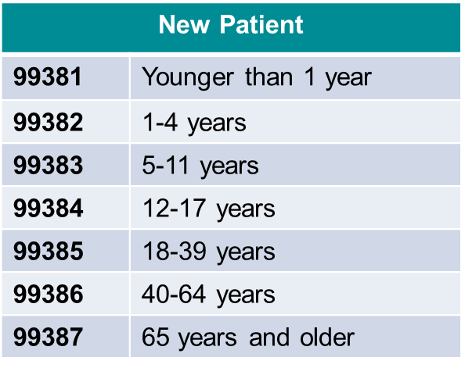
Preventive Medicine Visits
Seven codes are available in each of the two subcategories
Patient status (new vs. established) and age are the determining factors for code selection
Established Patient
99391 | Younger than 1 year
99392 | 1-4 years
99393 | 5-11 years
99394 | 12-17 years
99395 | 18-39 years
99396 | 40-64 years
99397 | 65 years and older

Slide 219
APPENDIX D
Preventive/Split Services
A coding job aid is available on eLink for your reference.

Slide 220
Preventive/Split Services
Preventive split visits may occur if during the course of a preventive encounter, the Physician/ACP identifies a significant new problem or exacerbation of chronic condition(s) requiring additional work over and above the normal preventive service, or an abnormality is discovered during the course of the encounter that needs to be evaluated/addressed
If the documentation conveys that two distinct services were provided – the preventive encounter and a problem-oriented service – two codes can be reported
  Problem-oriented E/M code (99201 – 99215) with modifier -25, and the
  Preventive service code (99381 – 99397)
Notes:
There is a letter given to patients explaining that he/she may incur a charge if a preventive/split is billed.

Slide 221
Preventive/Split Services
An issue is considered a “significant issue” when a new problem or an exacerbation of a pre-existing condition is discovered during the patient evaluation and the Physician/ACP determines the problem requires additional work to perform the key components of the problem-oriented office visit code
Remember that if you are considering billing a new patient encounter as a preventive split, all three key components (history, exam, and the complexity of the medical decision-making) must support the problem-oriented office visit code selected for billing
Simply refilling medications for stable chronic conditions does not constitute a separate medically necessary problem-oriented E/M encounter

Slide 222
Preventive/Split Services
The level of the problem-oriented E/M code is based on the “additional work” performed over and above what normally would be performed during the preventive encounter
Any work performed as part of the preventive encounter cannot be included when determining the level of the problem-oriented E/M code
Billing the problem-oriented visit based on time
  Documentation regarding the time spent providing the problem-oriented encounter must be included
  “Spent ___ minutes face-to-face with the patient addressing non-preventive conditions, and greater than 50% of that time was spent in counseling and/or coordination of care”
  Must state specifically what was discussed during counseling and/or what was done for coordination of care

Slide 223
Example - Preventive/Split Services
History: Patient presents for annual exam. He also complains of sharp pain in upper right abdomen for two weeks, primarily after eating. Patient also endorses increased belching and heartburn but denies nausea and vomiting. Patient has history of gallstones. (More information included …)
Exam: Patient is alert and oriented, in no acute distress. PERRLA. TMs clear. Lungs CTA, RRR, no edema. Normal gait and station. Normal sensation, DTRs. No obvious rashes or lesions.
Hypoactive bowel sounds, right upper quadrant guarding and tenderness. Enlarged spleen with palpable liver edge. No hernia.
Assessment and Plan:
Preventive exam: Counseled patient on healthy diet and exercise, use of seatbelt. Recommended sunscreen use, full skin exam in 6 months. Screening labs reviewed. Up-to-date on immunizations.
Abdominal pain: Order CBC, CMP, creatinine, hepatic function. If results are abnormal, obtain gallbladder ultrasound. Advised avoidance of fatty and spicy foods.

Slide 224
Preventive/Split Services and ICD-10-CM
In ICD-10-CM, the diagnosis codes for preventive encounters distinguish between a preventive exam with abnormal findings and a preventive exam without abnormal findings
An abnormal finding consists of:
  A significant new complaint or symptom described by the patient,
  An abnormal finding upon examination of the patient, or
  An acute exacerbation of a chronic condition

Slide 225
Preventive/Split Services and Medicaid
NC Medicaid
Beneficiaries 20 years of age or younger may receive a preventive exam and a sick visit on the same date of service
  Preventive split visits are not covered for patients 21 years of age and older
Physicians/ACPs must create separate notes for each service in order to support medical necessity
Only services performed above and beyond the preventive visit may be used to determine the sick visit level

Slide 226
APPENDIX E
Smoking Cessation Counseling

Slide 227
Smoking Cessation Counseling
Smoking cessation codes are defined based on the number of minutes spent providing counseling to the patient
** The number of minutes spent providing
the service must be documented **
CPT Code | Description
99406 | Smoking and tobacco use cessation counseling visit; intermediate, greater than 3 minutes up to 10 minutes
99407 | Smoking and tobacco use cessation counseling visit; intensive, greater than 10 minutes

Slide 228
Smoking Cessation Counseling
Medicare coverage criteria include:
  Counseling must be provided by a physician or an Advanced Clinical Practitioner (ACP)
  Physician/ACP must document intervention methods recommended
  Patient must be alert and competent
  Counseling is covered in both inpatient and outpatient settings
  Medicare co-payment, co-insurance and deductible are waived

Slide 229
Smoking Cessation Counseling
Medicare will cover two smoking cessation attempts per year
  Each attempt includes a maximum of 4 intermediate or 4 intensive sessions for a total of 8 sessions per 12-month period
Medicare Asymptomatic Diagnosis Codes
F17.210 – F17.211 Nicotine dependence, cigarettes
F17.220 – F17.221 Nicotine dependence, chewing tobacco
F17.290 – F17.291 Nicotine dependence, other product
Z87.891 Personal history of nicotine dependence (may not be reported with F17.2xx codes)
Medicare Symptomatic Diagnosis Codes
T65.211A – T65.214A Toxic effect of chewing tobacco
T65.221A – T65.224A Toxic effect of tobacco cigarettes (use additional code for exposure to 2nd hand smoke Z57.31, Z77.22)
T65.291A – T65.294A Toxic effect of tobacco and nicotine

Slide 230
Smoking Cessation Counseling
For Commercial payers, benefits may vary by payer and individual plan
US Department of Health and Human Services published the Clinical Practice Guidelines for the “5” A’s of brief intervention:
Ask about tobacco use
Advise to quit
Assess willingness to make a quit attempt
Assist in quit attempt
Arrange follow up

Slide 231
APPENDIX F
Commonly Performed
Office Procedures

Slide 232
Commonly Performed Office Procedures and Services
Cerumen Removal*
EKGs*
Ultrasounds
X-rays*
Laceration (Wound) Repairs*
Incision and Drainage (I&D)
Foreign Body Removal
* A coding job aid is available on eLink for your reference

Slide 233
Cerumen Removal 69209
Patient must be symptomatic and/or the impacted cerumen must be impeding proper evaluation of signs or symptoms experienced by the patient
Documentation must illustrate that the service required significant time and effort and was performed via irrigation/lavage
Service may be performed either by clinical staff (RN, LPN, CNA, CMA) or the Physician/ACP
For bilateral procedure, report 69209 with modifier -50

Slide 234
Cerumen Removal 69210
Patient must be symptomatic and/or the impacted cerumen must be impeding proper evaluation of signs or symptoms experienced by the patient
Documentation must illustrate significant time and effort was spent and use of an instrument was required to accomplish the procedure
Service must be performed by a physician or Advanced Clinical Provider (PA, NP)
For bilateral procedure, report 69210 with modifier -50

Slide 235
Cerumen Removal
Diagnosis codes for reporting cerumen removal services:
    ICD-10-CM diagnosis code options:
    H61.20 Impacted cerumen, unspecified ear
    H61.21 Impacted cerumen, right ear
    H61.22 Impacted cerumen, left ear
    H61.23 Impacted cerumen, bilateral

Slide 236
EKG Documentation Requirements
A specific order for the test must be documented and signed
The documentation must indicate that the test is reasonable and medically necessary
The Physician/ACP must document the cognitive work performed in the analysis of the EKG tracing
A complete documented interpretation and report must be prepared and signed by the Physician/ACP
Merely signing the computerized EKG printout and noting “agree” is not sufficient to support an interpretation and report

Slide 237
EKG Label
The following label is designed to meet the minimum documentation requirements and is available from Coding Support
In addition to recording his findings, the interpreting Physician/ACP should notate any comparison to a prior EKG documenting any changes on the EKG label.
The interpreting Physician/ACP should sign and date the EKG label.
Normal (Rate, Rhythm, Axis, Intervals and Wave Changes)
Except as specified _______________________________________
I have personally reviewed the EKG tracing and
Agree with computerized printout
Disagree with computerized printout as noted:
____________________________________________________
Comparison to Prior EKG dated _______ /_______ / _______
Unchanged
Changed as noted:
______________________________________________________
Signature/Date: Actual size: 1.5” x 3”

Slide 238
EKGs and Rhythm Strips: The Codes
93000 12 lead; tracing with interpretation and report
93005 12 lead; tracing only
93010 12 lead; interpretation and report only
93040 1 – 3 leads; tracing with interpretation and report
93041 1 – 3 leads; tracing only
93042 1 – 3 leads; interpretation and report only
** It is not appropriate to report 93042
for reviewing telemetry monitoring strips.**
Note: Provider-based clinics typically split bill their services. Therefore the “global” code (93000) would not be reported. The professional component (93010) is reported in the Physician/ACP billing system and the technical component (93005) is reported by the facility.

Slide 239
Ultrasound Documentation Requirements
A specific order for the test must be documented and signed
The documentation must indicate that the test is reasonable and medically necessary
The Physician/ACP must document the cognitive work performed in the analysis of the ultrasound images
A complete documented interpretation and report must be prepared and signed by the Physician/ACP
Merely signing the computerized ultrasound report and noting “agree” is not sufficient to support an interpretation and report

Slide 240
Ultrasound Label
The following label is designed to meet the minimum documentation requirements
I have personally reviewed the ultrasound images and
Agree with the examination report
Disagree with the examination report as noted:
_____________________________________________________
Conclusion/Clinical Impression:
Normal
Abnormal (specify) _________________________________
Provider Signature/Date ________________________________
The interpreting Physician/ACP should record his review and interpretation on the label.
The interpreting Physician/ACP should sign and date the label.
Notes:
Some practices have added this language to their report templates, in lieu of using the label.

Slide 241
X-Ray Documentation Requirements
When a global x-ray code is billed, the following must be documented:
  The reason for the x-ray,
  The body area or anatomical location x-rayed,
  The number of views taken,
  The findings (including any incidental findings),
  The Physician/ACP’s conclusions and clinical impression,
  The date of service, and
  The Physician/ACP’s signature

Slide 242
X-Rays
Professional component
  Reading and interpretation of images
  Written report of findings
Technical component
  Use of equipment and supplies
  Use of staff and facility
Over-read
  A quality assurance measure only, not separately billable
Global Service

Slide 243
Wound (Laceration) Repairs
Wound closure utilizing sutures, staples, or tissue adhesives such as Dermabond
  Simple repair (12001 – 12018) – used when wound is superficial and requires a simple one-layer closure
  Intermediate repair (12031 – 12057) – used when wound requires layered closure of deeper layers of subcutaneous tissue and superficial fascia in addition to skin closure; also can be used for single layer closure of heavily contaminated wounds that require extensive cleaning or removal of particulate matter
  Complex repair (13100 – 13153) – includes repairs that require more than a layered closure
    Note that these are not typically done in an office setting

Slide 244
Selecting Wound Repair Codes
Wound repairs are coded based on anatomical site, and type and length of repairs
The repaired wound should be measured and recorded in centimeters
When repairing multiple wounds, add together lengths of wounds from grouped anatomical sites repaired using same method (e.g., simple repair) and select one code
When repairing multiple wounds from different grouped anatomical sites and/or using different methods (e.g., one with a simple repair, another with an intermediate repair), select individual codes as necessary to represent the services performed

Slide 245
Selecting Wound Repair Codes
Placement of adhesive strips to close a laceration is not billable as a wound repair and would be considered simply a portion of an E/M service
Use of Dermabond adhesive may be reported as a simple repair
Suture removal following a laceration repair is included in the wound repair itself and should not be separately billed

Slide 246
Selecting Wound Repair Codes
Example: Patient is in an MVA where they sustain a laceration on their forehead and another laceration on their arm. The laceration on the forehead measures 3.1 cm and is repaired using a simple repair. The laceration on the arm measures 5.2 cm and is closed using an intermediate repair (layered closure). The CPT codes for this scenario are:
12032 Repair, intermediate, wounds of scalp, axillae, trunk
and/or extremities; 2.6 cm to 7.5 cm
12013-59 Simple repair of superficial wounds of face, ears,
eyelids, nose, lips and/or mucous membranes; 2.6 cm
to 5.0 cm

Slide 247
Incision and Drainage (I&D) Codes
I&D services performed in an office setting are typically found in the Integumentary Section of the CPT book
Codes include the following:
  10060 I&D of abscess, simple or single
  10061 I&D of abscess, complicated or multiple
  10140 I&D of hematoma, seroma or fluid collection
  10160 Puncture aspiration of abscess, hematoma, bulla,
  or cyst
Typically no wound closure is needed although a simple drain may be required
Includes use of topical anesthesia

Slide 248
Incision and Removal of a Foreign Body
Services performed in the office setting include the following:
  10120 Incision and removal of foreign body, subcutaneous
  tissues; simple
  10121 Incision and removal of foreign body, subcutaneous
  tissues; complicated
To support billing of these codes, the documentation must indicate that it was necessary to make a simple incision or to extend the edges of the wound in order to remove the foreign body
If the foreign body can be removed simply by grasping it with forceps and pulling it out, the service is not separately billable and is considered part of the E/M service

Slide 249
APPENDIX G
Advance Care Planning

Slide 250
Advance Care Planning
Advance Care Planning is essentially the explanation and discussion of advance directives, including standard forms (with completion of such forms, when performed)
Advance Care Planning may be provided and reported by a:
  Physician
  Advanced Clinical Practitioner (e.g., NP, PA)
Other staff members may assist with certain aspects of the service

Slide 251
Advance Care Planning:
General Requirements
Requires a face-to-face visit with the physician or Advanced Clinical Practitioner and a patient, family member, or surrogate
Counseling and discussion of advanced directives may or may not include completion of relevant legal documents
Since this is a time-based service, time must be documented by the Physician/ACP
Services may be provided using a team-based approach by including other staff under the order and medical management of the patient’s treating physician
Notes:
Risk Areas – face-to-face visit with Physician/ACP and patient/family/surrogate not documented; time not documented.

Slide 252
Advance Care Planning:
General Requirements
Order and/or plan of care is necessary and must be documented
Physician and/or Advanced Clinical Practitioner participates and contributes to the provision of this service
Advance Care Planning services are voluntary and beneficiaries should be given a clear opportunity to decline if they prefer to receive assistance and/or counseling from other nonclinical sources outside the Medicare program
Co-pay and deductible DO apply unless the service is provided during an Annual Wellness Visit (AWV)
Notes:
The Physician/ACP must document that the patient was given the opportunity to decline the service.

Slide 253
Advance Care Planning:
Reporting in the Office Setting (POS 11)
“Incident to” guidelines applicable
A signature macro may be used by the supervising Physician/ACP when the Advance Care Planning service is performed “incident to”:
  “In addition to providing direct supervision, I have actively managed, participated and contributed to the delivery of the advance care planning service.”
This statement would only need to be used when the Advance Care Planning service is performed “incident to”
In cases where the Physician/ACP bills directly, only the Physician/ACP’s signature is needed in addition to their documentation

Slide 254
Advance Care Planning:
Reporting in the Office Setting (POS 11)
“Incident to” guidelines applicable
When Advance Care Planning services are performed “incident to”, there needs to be evidence of the following in the medical record:
  Physician initiates request/order for advance care planning
  Beneficiary’s approval
  Advance Care Planning services furnished under supervisory physician’s overall direction and control
  Physician activity/involvement frequently enough to reflect active participation/management
  Physician’s involvement should be documented in the medical record
  Physician must be on-site and immediately available (i.e., direct supervision)

Slide 255
Advance Care Planning:
Reporting in the Office Setting (POS 11)
Medicare requires direct physician supervision (i.e., immediately available and in the office suite)
May be billed separately with Annual Wellness Visit
Modifier -33 should be appended to the service code
No copay or deductible applies when performed during an AWV
May be reported during Transitional Care Management (TCM), Chronic Care Management (CCM), or global surgery period
May be reported in the same session with other E/M services – Except when performed during a “Welcome to Medicare” (IPPE) service

Slide 256
Advance Care Planning:
Reporting in the Hospital of NF Setting
“Incident to” criteria not applicable
Must be personally performed and reported by the Physician/ACP
May be reported in the same session with other E/M services – Except when performed during critical care, neonatal critical care, pediatric critical care, initial and continuing intensive care services

Slide 257
Advance Care Planning
CPT Code | Description
99497 | Advance care planning including the explanation and discussion of advance directives such as standard forms (with completion of such forms, when performed), by the physician or other qualified healthcare professional; first 30 minutes, face-to-face with the patient, family member(s) and/or surrogate
+ 99498 | each additional 30 minutes

Slide 258
APPENDIX H
Telehealth Services

Slide 259
Telehealth Services
Documentation of a telehealth service should be the same as that required for any in-person patient encounter. However, the documentation must also include the following:
  A statement that the service was provided via telemedicine,
  Location of the patient,
  Location of the Physician/ACP,
  Name of any referring Physician/ACP, and
  The names of all Physicians/ACPs present during the telemedicine service and their role in the patient’s care

Slide 260
Telehealth Services
For payment, Medicare requires an “interactive telecommunications” system that at a minimum includes audio and video for 2-way, real-time communication
  Virtual care services, where the patient initiates the encounter via a computer, iPad, iPhone, etc., are not considered “telehealth” services for the purposes of Medicare payment
Virtual Visit (On-line Medical Evaluation with Patient) | Patient initiates audiovisual contact with Physician/ACP via iPad, iPhone, computer, etc.
eVisit (On-line Medical Evaluation with Patient) | Patient initiates electronic communication with Physician/ACP via iPad, iPhone, computer, etc.
TeleMedicine (Face-to-Face with Patient via audiovideo communication) | Physician/ACP at ‘originating’ site (patient location) initiates contact w/’distant’ site Physician/ACP using 2-way, synchronous audiovideo telecommunication technology

Slide 261
Telehealth Services
Originating Site:
  The site where the beneficiary is located at the time the telehealth service is being furnished
  Approved telehealth sites:
Physician Office
Hospital
Critical Access Hospital
Rural Health Clinics
Federally Qualified Health Centers
Skilled Nursing Facilities
Community Mental Health Centers
Hospital-based or Critical Access Hospital-based Renal Dialysis Centers (including satellites)
Note: Independent renal dialysis facilities are not eligible as originating sites
As of 2016, the Primary Enterprise hospital locations eligible for the telehealth originating site charge and payment are Anson, Kings Mountain, Cleveland, and Stanly
Distant Site:
  The site where the Physician/ACP, providing the professional service, is located at the time the telehealth service is provided

Slide 262
Telehealth Services
Telehealth Modifiers
Modifier | Description
-GT | Via interactive audio and video telecommunication systems
-95 | Synchronous telemedicine service rendered via a real-time interactive audio and video telecommunications system
By appending a –GT modifier, the distant site Physician/ACP is certifying that a covered telehealth service was furnished
The -95 modifier indicates that a service has been performed that meets the “interactive communications” requirements of a telehealth service

Slide 263
APPENDIX I
Alcohol/Substance Abuse
Screening, Brief Intervention, and
Referral to Treatment Services
(SBIRT)

Slide 264
SBIRT Overview
Screening – use a tool to identify risky substance use behaviors, such as the Single Question Screen or the Quick Screen
Brief Intervention – focus on increasing patient awareness and changing behavior to prevent progression of substance abuse when a hazardous behavior pattern is identified
Referral and Treatment – facilitate access to more advanced treatment options and support

Slide 265
SBIRT Coverage
Medicare covers medically necessary SBIRT services when performed in a physician office or outpatient hospital department
Medicare | Commercial Payer | Description
G0442 | 99420 | Administration and interpretation of health risk assessment instrument (i.e. DAST or AUDIT)
G0396 | 99408 | Alcohol and/or substance abuse structured screening and brief intervention services; 15 to 30 minutes
G0397 | 99409 | Alcohol and/or substance abuse structured screening and brief intervention services; greater than 30 minutes
* G0396 and G0397 (CPT codes 99408 and 99409) are time based codes; therefore the amount of time spent providing these services must be documented

Slide 266
SBIRT with an E/M Service
If a significant and separately identifiable E/M service is provided during the same encounter as SBIRT, both services may be reported
Modifier -25 should be appended to the E/M code
Appropriate documentation must be present in the medical record to support reporting the E/M visit and SBIRT services

Slide 267
APPENDIX J
Transitional Care Management
(TCM) Services

Slide 268
Transitional Care Management Services
Purpose of these services is to ensure that patients whose medical and/or psychosocial conditions require moderate or high complexity decision-making are seen in a physician’s office following discharge rather than be at risk for readmission
Can be billed only once in the 30 days following discharge by a single community Physician/ACP
The reporting individual provides or oversees the management and/or coordination of services, as needed, for all medical conditions, psychosocial needs, and activities of daily living support by providing first contact and continuous access
The transitional care period commences upon the date of discharge and continues for the next 29 days

Slide 269
Transitional Care Management Services
Require one face-to-face visit within a specified time frame in combination with non face-to-face services
Medication reconciliation and management must occur no later than the date of the face-to-face visit
May be reported for new or established patients during transitions described below
From | To
• Inpatient hospital setting (acute, rehab, long-term acute), | Patient's community setting (home, domiciliary, rest home or assisting living facility)*
• Partial hospitalization programs,
• Hospital observation, or
• Skilled nursing facility (SNF)
TCM codes may not be billed for patients discharged to a SNF

Slide 270
Transitional Care Management Services
Transitional care management services codes
CPT Code | Required elements per code description
99495 | • Communication (direct contact, telephone, electronic) with the patient and/or caregiver within 2 business days of discharge*
 | • Medical decision making of at least moderate complexity during the service period
 | • Face-to-face visit with Physician/ACP within 14 calendar days of discharge
* Communication may be made by licensed clinical staff under the Physician/ACP’s direction

Slide 271
Transitional Care Management Services
Transitional care management services codes
CPT Code | Required elements per code description
99496 | • Communication (direct contact, telephone, electronic) with the patient and/or caregiver within 2 business days of discharge*
 | • Medical decision making of at least high complexity during the service period
 | • Face-to-face visit with Physician/ACP within 7 calendar days of discharge
* Communication may be made by licensed clinical staff under the Physician/ACP’s direction

Slide 272
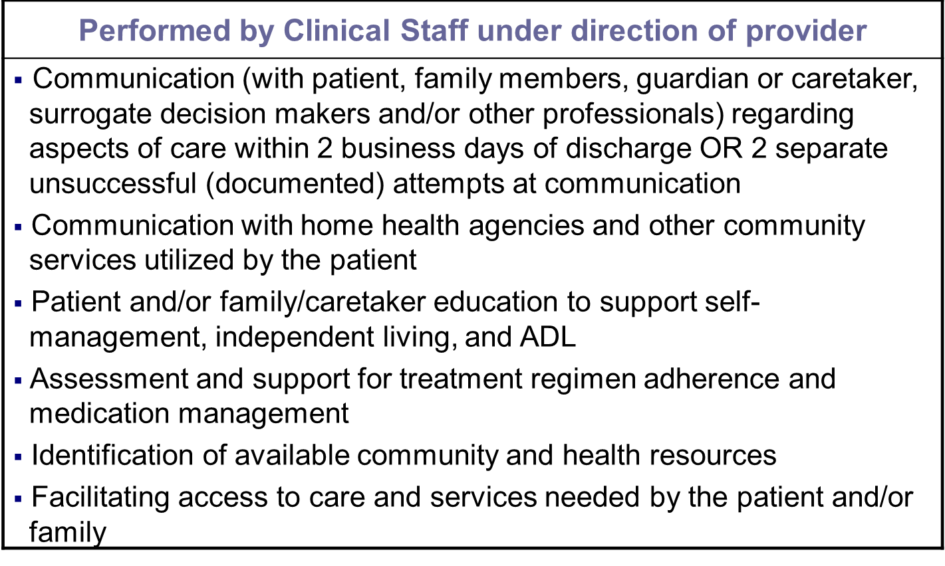
Transitional Care Management Services
Non face-to-face services include:

Slide 273
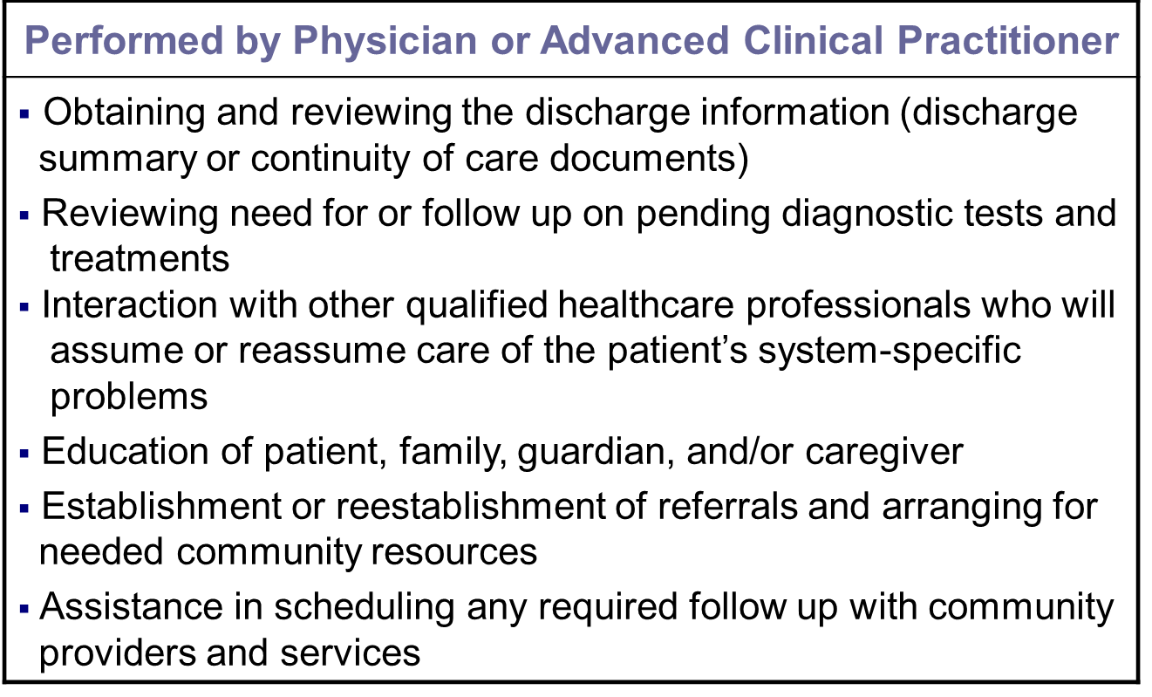
Transitional Care Management Services
Non face-to-face services include:

Slide 274
Transitional Care Management Services
E/M services after the first face-to-face visit may be billed separately
The first face-to-face visit is part of the TCM service and may not be separately billed
A Physician/ACP that bills for a procedure with a 10 or 90-day global period may not also report the TCM code when performed within the postoperative management period
If another admission and discharge occur within the initial 30-day period following a discharge, a second TCM code may not be reported

Slide 275
Transitional Care Management Services
The following services may not be reported during the time period covered by the TCM codes:
  Care plan oversight (G0181, G0182, 99339, 99340, and 99374-99380)
  Prolonged services without direct patient contact (99358 and 99359)
  Anticoagulant management (99363 and 99364)
  Medical team conferences (99366 – 99368)
  Education and training (98960-98962, 99071 and 99078)
  Telephone services (98966 – 98968 and 99441 – 99443)
  End stage renal disease services (90951 – 90970)
  Online medical evaluation services (98969 and 99444)
  Preparation of special reports (99080)
  Analysis of data (99090 and 99091)
  Complex chronic care coordination services (99487 – 99489)
  Chronic care management services (99490)
  Medication therapy management codes (99605-99607)
  Home and Outpatient INR monitoring (93792-93793)

Slide 276
APPENDIX K
Home Health Face-to-Face
Requirements (Medicare)

Slide 277
Home Health Face-To-Face Requirements
(Medicare)
Physician or ACP certifying a patient’s eligibility for the home health benefit must have a face-to-face encounter with the patient
Face-to-face encounter must occur during following timeframes:
  90 days prior to the home health care start date OR
  30 days after the home health care start date
Medical record documentation must include:
  Description of patient’s clinical condition during the encounter AND
  How the patient’s clinical condition supports the homebound status and the need for skilled services
If the Physician/ACP’s documentation does not support home health, services may be denied

Slide 278
Home Health Face-To-Face Requirements
(Medicare)
Example:
Ms. Smith is temporarily homebound following a total knee replacement on xx/xx/xxxx. She is currently walker dependent with painful ambulation. PT is needed to restore her ability to walk without support.
National statistics released by Medicare Administrative Contractors (MACs) indicate that over 80 percent of the home health claim denials are due to insufficient physician narratives related to a patient’s home bound status and need for skilled care

Slide 279
APPENDIX L
Advance Beneficiary Notice of Non-Coverage (ABN)

Slide 280
Advance Beneficiary Notice of
Non-Coverage (ABN)
When a determination is made that a service is not reasonable and necessary, a Medicare beneficiary is not liable for payment unless the beneficiary received written notice (i.e., ABN) of possible non-coverage in advance of receiving the service
The ABN gives the patient notice that Medicare may not pay for a test or service and an opportunity to make an informed decision about whether to proceed with the test or service

Slide 281
Advance Beneficiary Notice of
Non-Coverage (ABN)
ABNs should NOT be obtained if there is not a specific, identifiable reason to believe that Medicare will not pay for the service(s)
Blanket ABNs are not acceptable
An ABN or waiver should never be obtained from a Medicare Advantage patient

Slide 282
Questions?

